Slide 2
What I need to have ready…
My Fluency Book and Maths book
A sharp pencil
A long ruler
A rubber
A green pen for marking
A red, orange and green coloured pencil to self assess
A whiteboard and pen
The 5Bs: Brain, Book, Board, Buddy, Boss

Slide 3
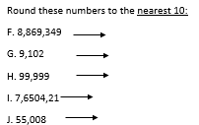
Complete the following in your small Maths Fluency Books please

Slide 4
Draw a ruler margin, then write the date and WALT and underline please
28-9-23
WALT understand negative numbers

Slide 5
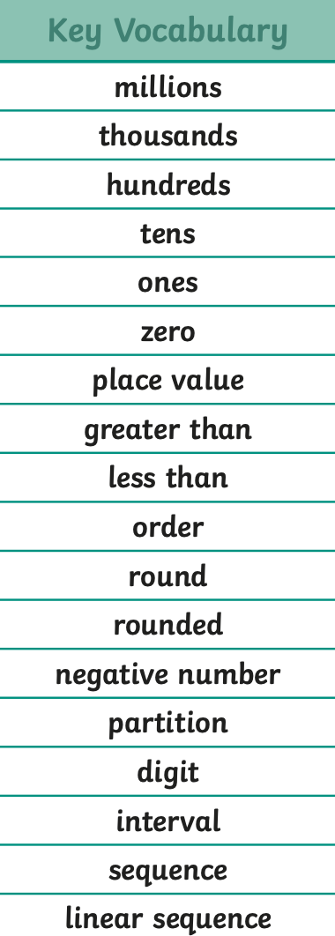
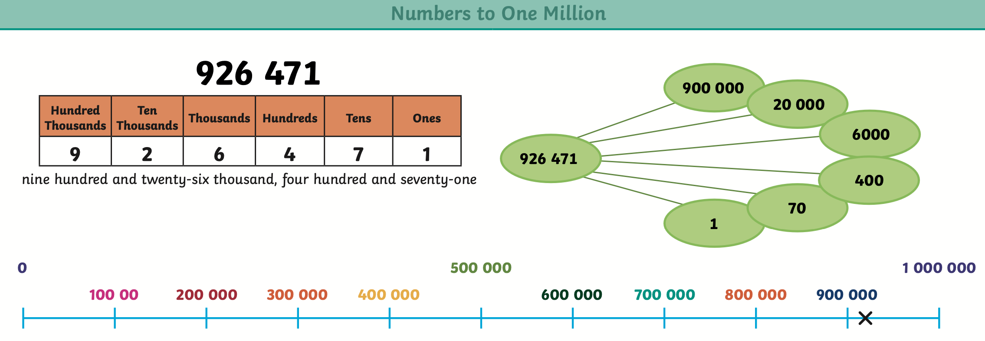
Need to Know

Slide 6
Recap
What did we learn in our last lesson?
How do you think that can help us today?
Which resources do you think will help us?

Slide 7
Re-Cap
1) Complete the number line.
2) 0 $−$ 1 $=$
3) What is 3 less than 1?
4) What is 4 more than negative 2?
$−$1
0
2
3

Slide 8
$−$5
$−$4
$−$3
$−$2
$−$1
0
1
2
3
4
5
Where have you seen negative numbers before?

Slide 9
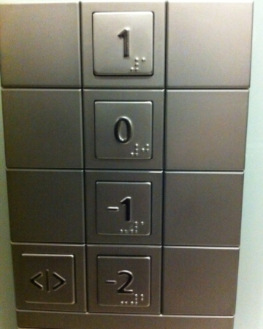
Teach it ​
Temperature -
when the temperature is below freezing (0$℃$), it is shown as a negative number
Eva has £10 in her bank account and buys a coat for £15
She now has £$−$5
Negative numbers can be used to measure under sea level
Lift

Slide 10
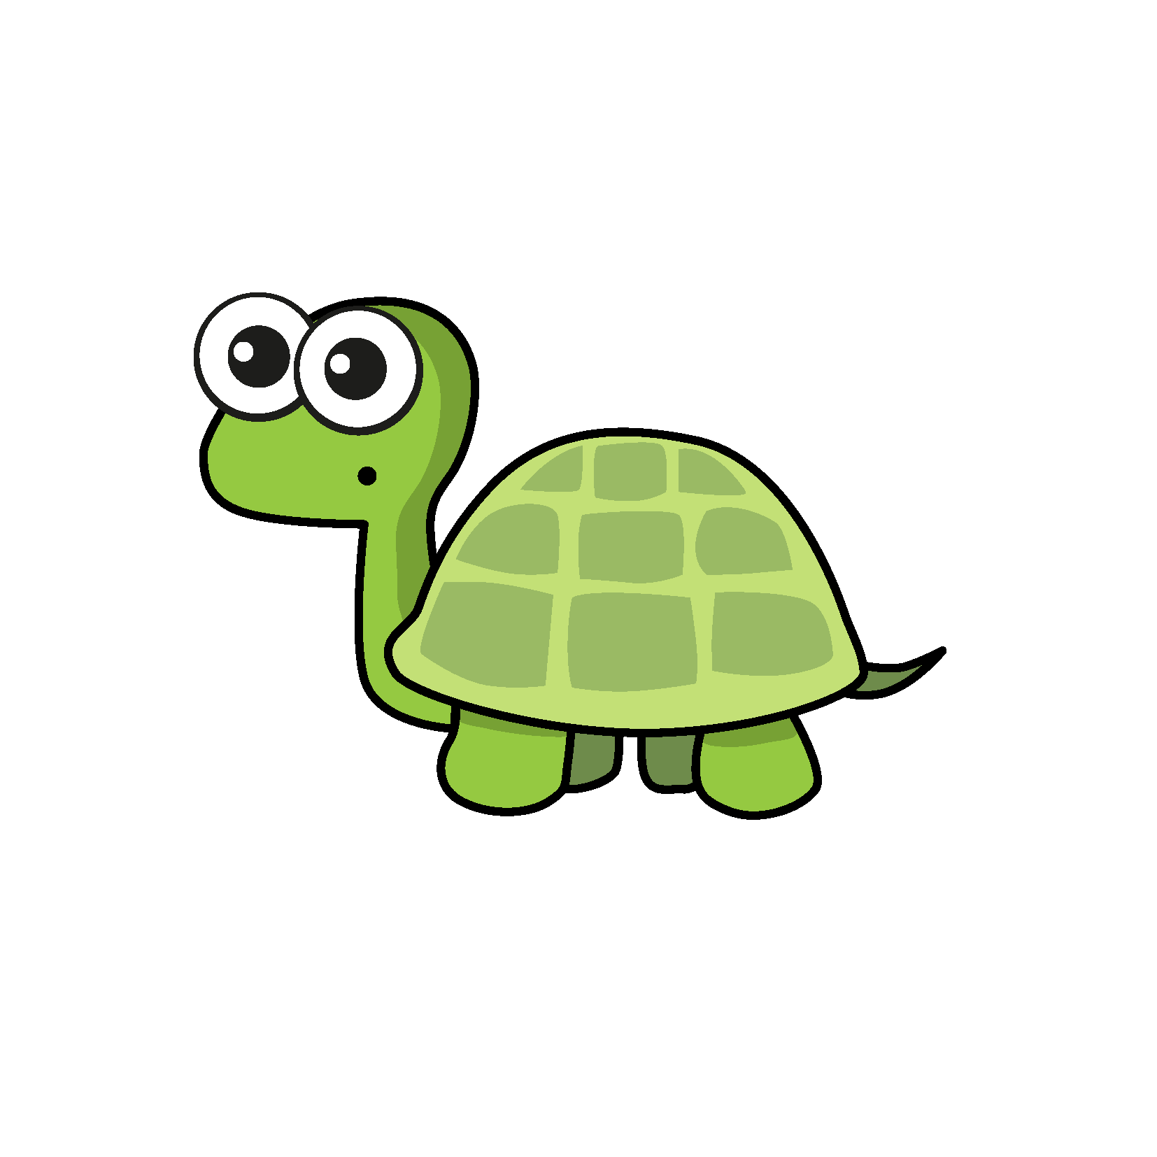
Teach it ​
The number line looks correct to me!
$−$1
$−$2
$−$3
$−$4
$−$5
0
1
2
3
4
5

Slide 11
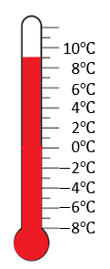
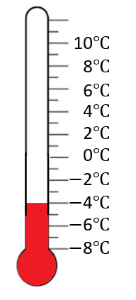
Teach it ​
London | Chicago
9$℃$ | $−$4$℃$
How many degrees warmer is it in London?
$−$10
$−$9
$−$8
$−$7
$−$6
$−$5
$−$4
$−$3
$−$2
$−$1
0
1
2
3
4
5
6
7
8
9
10
4
9
$−$4
0
9
13$℃$ warmer in London

Slide 12
Guided Practice ​
$−$4 $+$ 5 $=$
1
$−$4 $−$ 5 $=$
$−$9
5 more than $−$4
5 less than $−$4
$−$10
$−$9
$−$8
$−$7
$−$6
$−$5
$−$4
$−$3
$−$2
$−$1
0
1
2
3
4
5
6
7
8
9
10
What’s the same and what’s different?

Slide 13
Guided Practice ​
$−$4 $+$ 5 $=$
1
4
1
$−$5
$−$4
$−$3
$−$2
$−$1
0
1
2
3
4
5
4
1

Slide 14
Teach it ​
Complete the number lines.
$−$2.5
$−$2
$−$1.5
$−$1
$−$0.5
0
0.5
1
1.5
2
2.5
2
$−$1
$−$0.8
$−$0.6
$−$0.4
$−$0.2
0
0.2
0.4
0.6
0.8
1
2 $÷$ 10 $=$ 0.2

Slide 15
Guided Practice ​
What is A $+$ B?
$−$16
24
4
A
$−$12
$−$8
$−$4
0
B
16
24 $÷$ 6 $=$ 4
$−$16 $+$ 4 $=$
$−$ 12
8
16
$−$8
0
16

Slide 16
Guided Practice ​

Slide 17
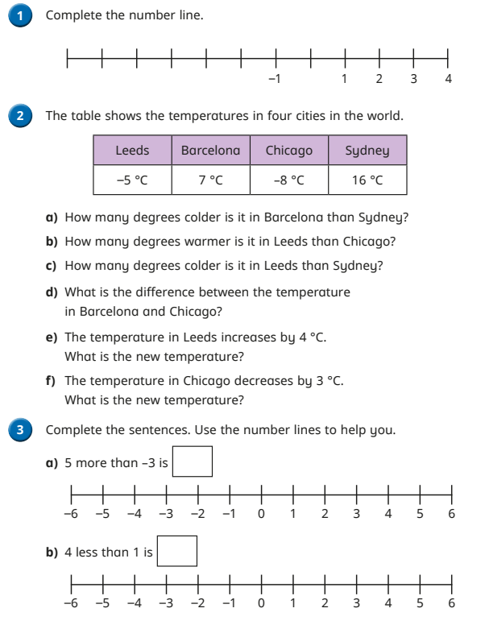
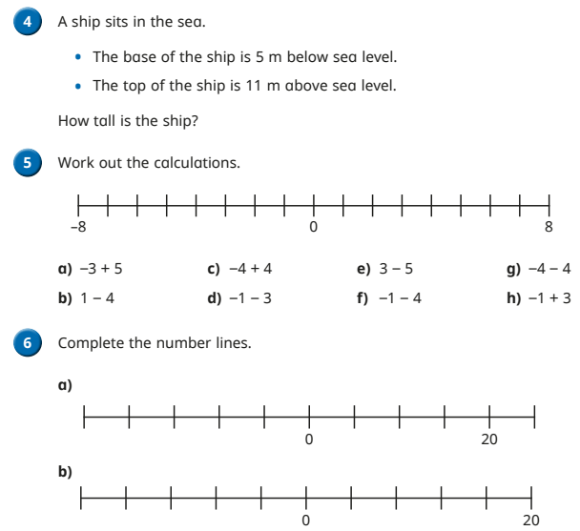
Do it
Secure it

Slide 18
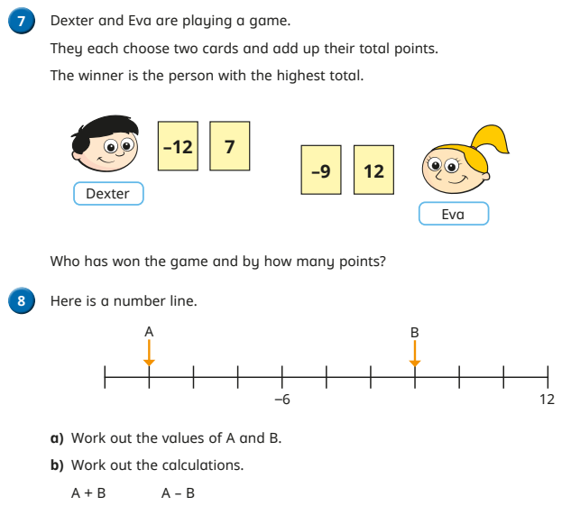
Deepen it

