Slide 3
What I need to have ready…
My Fluency Book and Maths book
A sharp pencil
A long ruler
A rubber
A green pen for marking
A red, orange and green coloured pencil to self assess
A whiteboard and pen
The 5Bs: Brain, Book, Board, Buddy, Boss

Slide 4
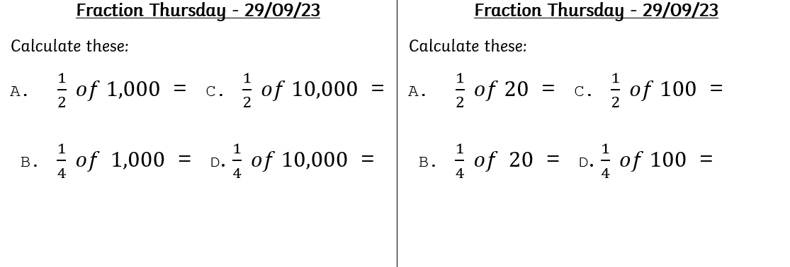
Fluency
Year 4
Year 3

Slide 5
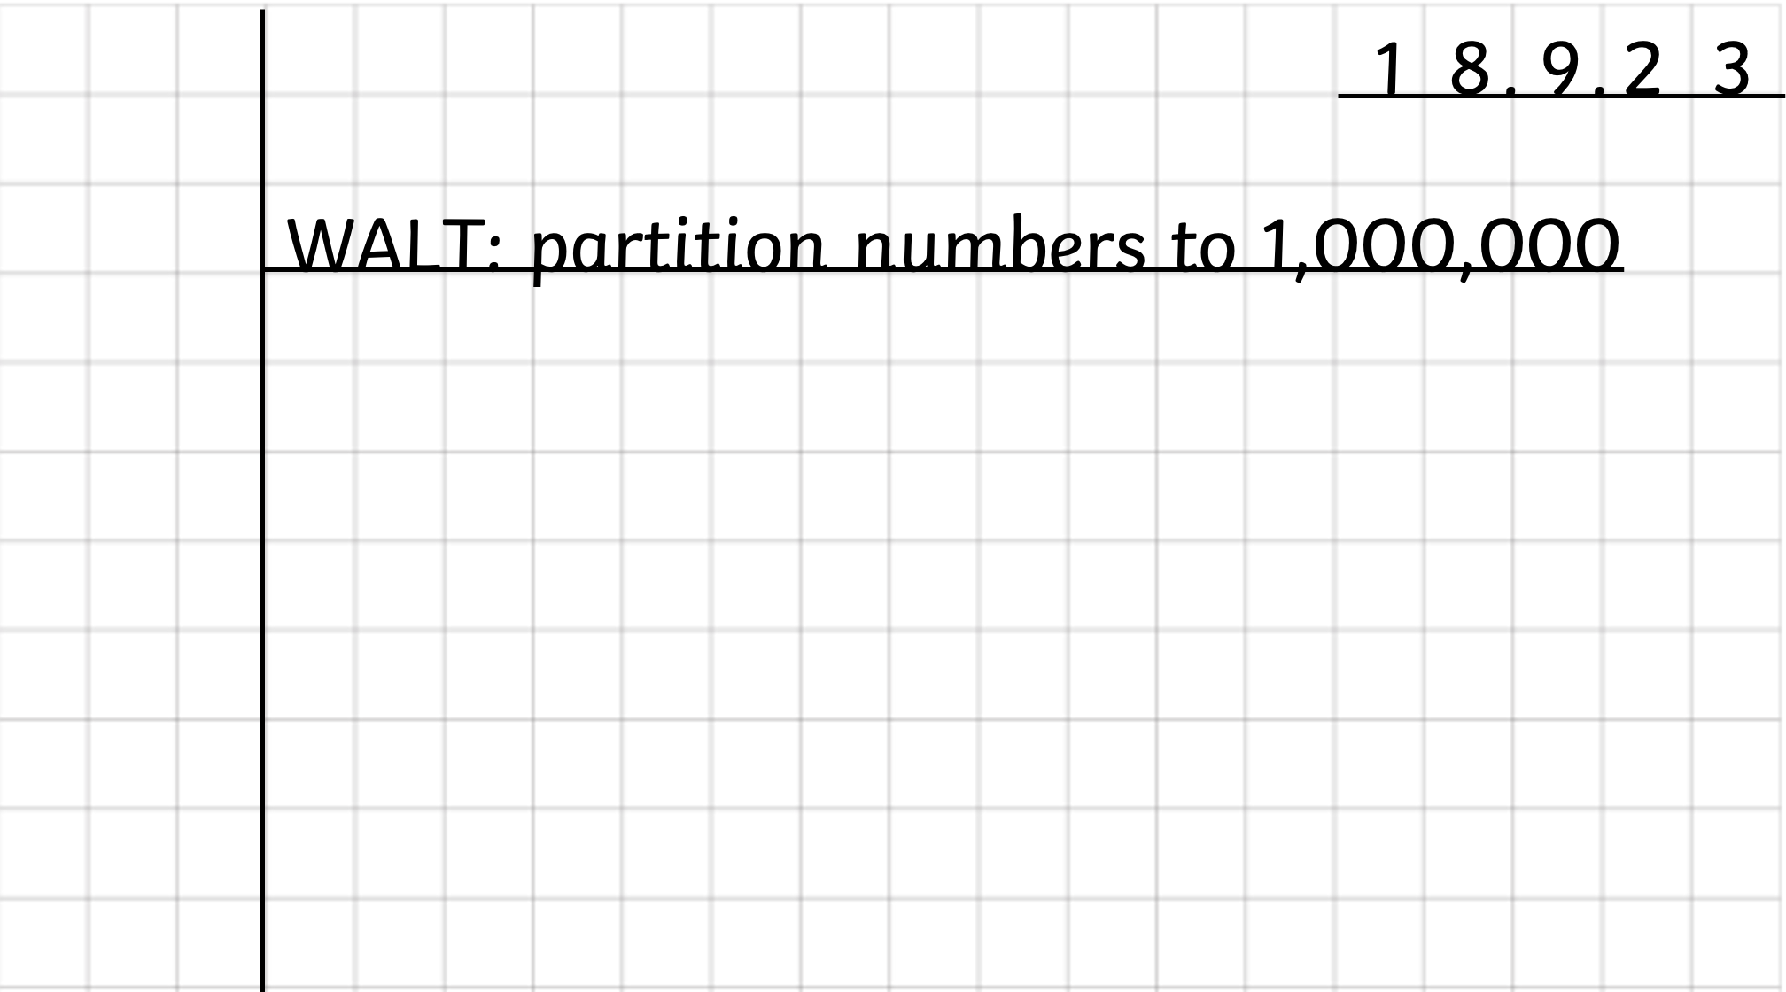
Draw a ruler margin, then write the date and WALT and underline please
2 9 . 0 9. 2 3
WALT – know the Roman Numerals up to 100.

Slide 6
Independent Practice

Slide 7
1) Partition 72.
2) What is 10 more than 50?
3) Subtract 10 from one hundred.
4) 50 $+$ 10 $+$ 10 $+$ 5 $+$ 1 $=$

Slide 8
1) Partition 72 into tens and ones.
2) What is 10 more than 50?
3) Subtract 10 from one hundred.
4) 50 $+$ 10 $+$ 10 $+$ 5 $+$ 1 $=$
72 $=$ 70 $+$ 2
60
90
76

Slide 10
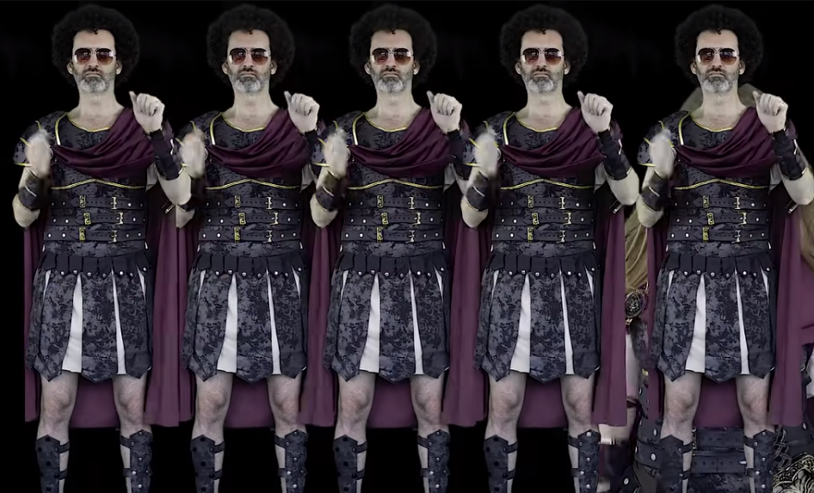
https://www.youtube.com/watch?v=z1UmAgekzbs

Slide 11
Where might you see Roman Numerals in real life?

Slide 12
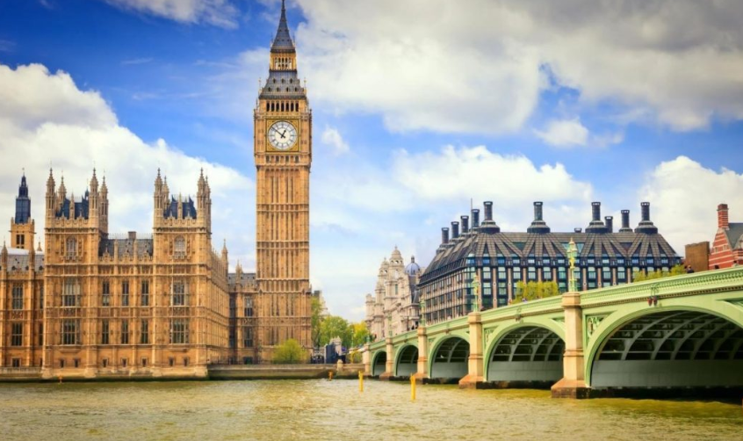

Slide 13
King Charles III

Slide 14
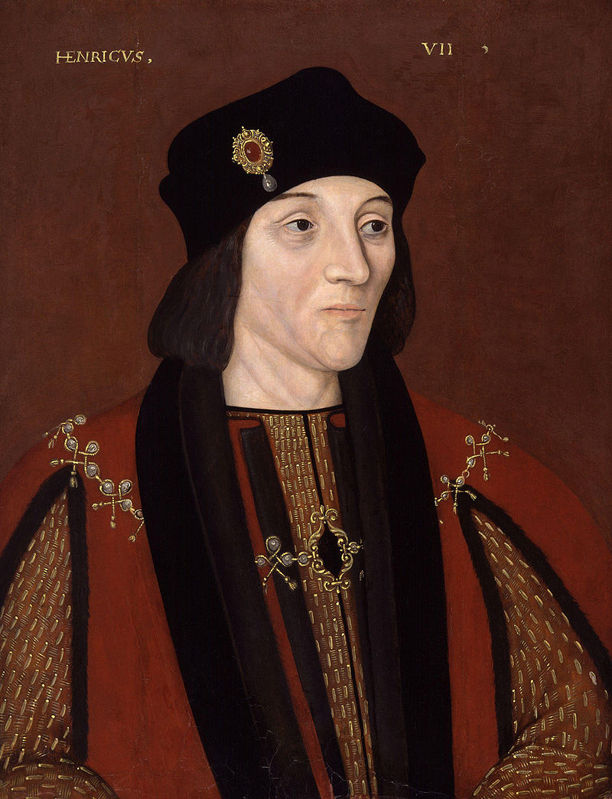
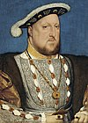
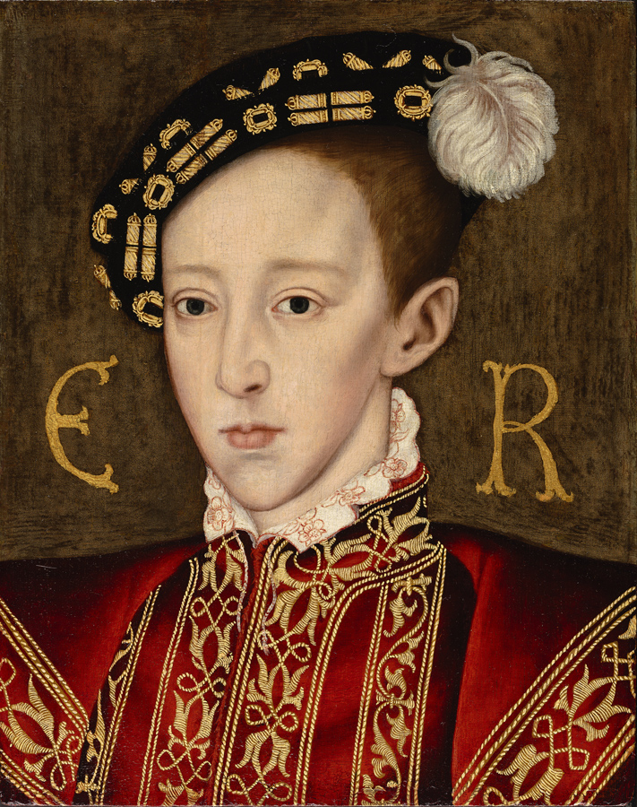
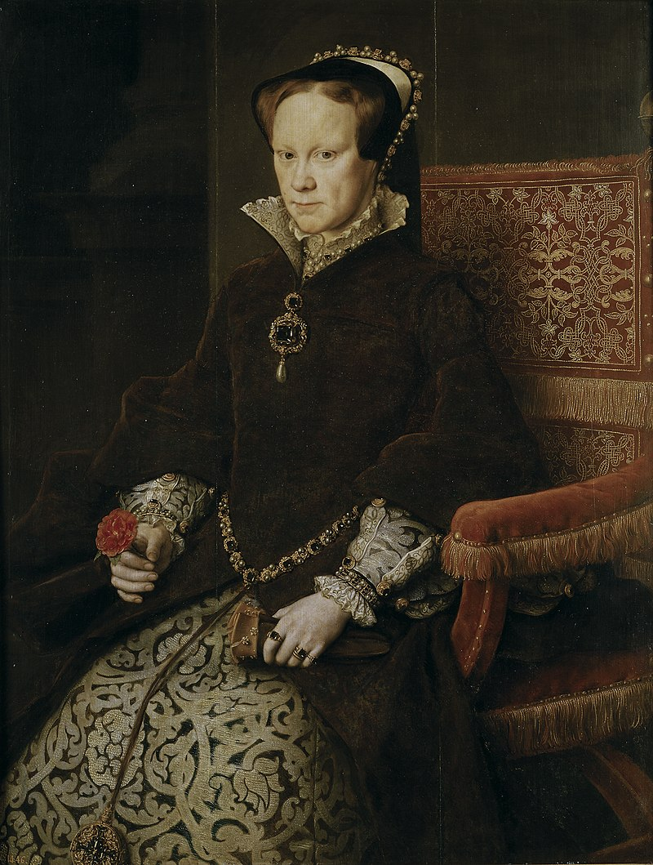
Henry VII
Henry VIII
Edward VI
Mary I
We’re learning about monarchs in Tudor times.
The numbers look a bit different to how we say them.

Slide 15
Roman numerals are written with a combination of symbols.
I $=$ 1
V $=$ 5
X $=$ 10
L $=$ 50
C $=$ 100
A maximum of three of the same symbol can be used in a number.
When a symbol is written after a larger or equal symbol, it is added.
When a symbol is written before a larger symbol, it is subtracted.

Slide 16
I
II
III
IV
V
VI
VII
VIII
IX
X
IIII
XI | XII | XIII | XIV | XV | XVI | XVII | XVIII | XIX | XX
Have a think
I $=$ 1
V $=$ 5
X $=$ 10
L $=$ 50
C $=$ 100

Slide 17
Henry 7
Henry VII
Edward 6
Henry VIII
Edward VI
Henry 8
Mary 1
Mary I
So Henry VIII is Henry the 8th!
He’s the one who had 6 wives.
That’s VI in Roman numerals!
Have a think

Slide 20
1 | 2 | 3 | 4 | 5 | 6 | 7 | 8 | 9 | 10
11 | 12 | 13 | 14 | 15 | 16 | 17 | 18 | 19 | 20
21 | 22 | 23 | 24 | 25 | 26 | 27 | 28 | 29 | 30
31 | 32 | 33 | 34 | 35 | 36 | 37 | 38 | 39 | 40
41 | 42 | 43 | 44 | 45 | 46 | 47 | 48 | 49 | 50
51 | 52 | 53 | 54 | 55 | 56 | 57 | 58 | 59 | 60
61 | 62 | 63 | 64 | 65 | 66 | 67 | 68 | 69 | 70
71 | 72 | 73 | 74 | 75 | 76 | 77 | 78 | 79 | 80
81 | 82 | 83 | 84 | 85 | 86 | 87 | 88 | 89 | 90
91 | 92 | 93 | 94 | 95 | 96 | 97 | 98 | 99 | 100
26 $=$
XX
VI
46 $=$
XL
VI
76 $=$
LXX
VI
96 $=$
XC
VI
What do you notice?
The tens column changes but there is a 6 in the ones represented as VI

Slide 21
The diagram shows a number in numerals, words and Roman numerals.
thirty- one
Have a think
31
XXXI
Complete the diagrams.
fifty-nine
ninety-five
59
LIX
95
XCV

Slide 22
A number is put into a function machine.
What will be the new number?
XLIII
XLI
$+$ 2
?
41
$+$ 2
43

Slide 23
A number is put into a function machine.
What will be the new number?
XXVII
XXIX
$−$ 2
?
29
$−$ 2
27

Slide 24
Tiny is adding Roman numerals.
VI $+$ IV $=$
X
VIIV
6 $+$ 4 $=$ 10
Have a think

Slide 25
Independent Practice

Slide 26
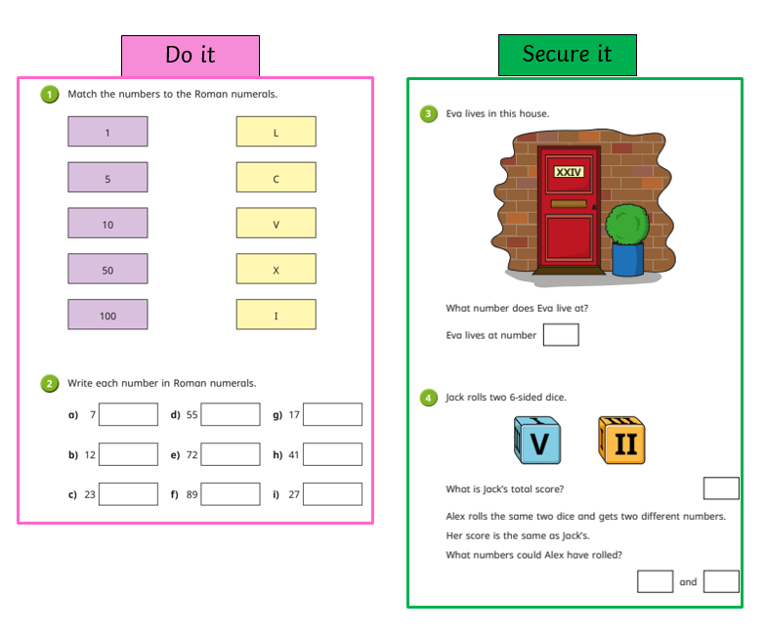

Slide 27
