Slide 1
Working scientifically objectives covered
Ask simple questions and recognise that they can be answered in different ways
Observe closely, using simple equipment
Perform simple tests
Identify and classify
Use their observations and ideas to suggest answers to questions
Gather and record data to help in answering questions

Slide 2
Year 1

Slide 3
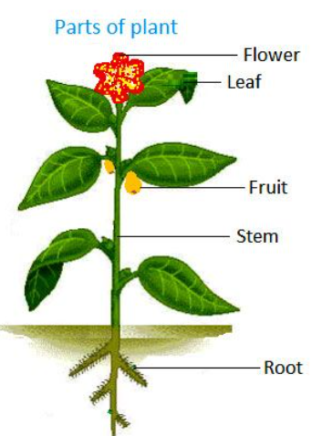
Year 1 – Plants: How can we identify different plants and trees?
Lesson 1 | Lesson 2 | Lesson 3 | Lesson 4 | Lesson 5 | Lesson 6 | Lesson 7
Key question: What is a plant? | Key question: What are the parts of a plant called? | Key question: What is a leaf? | Key question: Do plants grow and what wild plants grow in our local area? | Key question: How can we group plants? | Key question: Can we eat plants? | Key question: Are trees a type of plant?
Key vocabulary –
plant – a living organism
tree – a woody plant
deciduous – a tree that loses its leaves annually
evergreen – a tree the does not lose its leaves
flower – the seed bearing part of a plant that is usually surrounded by brightly coloured petals
roots – the part of the plant that attaches into the ground for support and nutrient collection
stem – the main stalk of a plant
leaf – part of a plant that is typically flat and hangs off the stem
Overview of learning
Misconceptions
Children will learn about different wild and common plants and label their basic features. They will look for wild plants in their local area and discuss plants that we can eat. They will then look at trees and their basic features. Children will look at the difference between deciduous and evergreen trees before looking at different leaves from trees. Children will plant a seed in lesson 3 and keep a plant diary during the rest of the lessons to show how their plant grows and changes.
Children may not realise that plants are living things and that they can die.
They may only think things with faces and brains are alive.
Children may not know that plants have roots in the ground that help the plant.
The might not know that vegetables are also part of plants.
Knowledge And Understanding Objectives
Pupils should be taught to:
identify and name a variety of common wild and garden plants, including deciduous and evergreen trees
identify and describe the basic structure of a variety of common flowering plants, including trees.

Slide 4
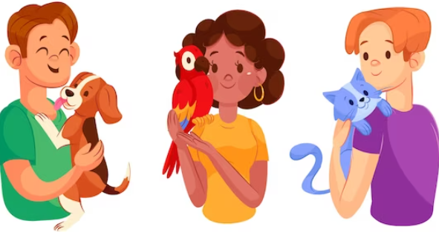
Year 1 – Animals including humans: How can we group animals?
Lesson 1 | Lesson 2 | Lesson 3 | Lesson 4 | Lesson 5 | Lesson 6
Key question: What is this animal? | Key question: How are animals different? | Key question: Do all animals eat the same thing? | Key question: What are our body parts called? | Key question: What are senses? | Key question: Are all humans the same?
Key vocabulary –
animal – a living thing
herbivore – an animal that just eats plants
carnivore – an animal that just eats meat
omnivore – an animal that eats both plants and animals
mammal – a type of animal that has hair on its body and drinks milk
bird – a type of animal with feathers, wings and a beak fish – a type of animal with scales, fins and lives in water reptile – a type of animal with scales that lives on land
amphibian – a type of animal that is born in water but then develops lungs and lives on land
Children should be taught to name the main body parts including head, neck, arms, elbows, legs, knees, face, ears, hair, mouth, teeth, abdomen, chest, shoulders and toes
Overview of learning
Misconceptions
Children will learn about different common animals and be able to discuss their features using scientific language such as feathers, beak, scales, fins etc. They will begin to identify similarities and differences between different animals. Children will also look at the diets of different animals and compare these. Finally, children will focus on humans, identifying body parts and linking these to senses as well as discussing the similarities and differences between humans.
Children might think that all animals eat the same thing. They may not realise that animals eat different things. There may also be misconceptions about animals eating humans e.g. sharks eat humans. This needs to be discussed that no animals hunt humans and that we do not live in the same habitat.
Children may discuss how all humans have two arms/two legs/eyes to see/ears to hear. Teachers may want to discuss how some children have disabilities so do not have all the same body parts or cannot use all of their senses to show diversity and inclusivity.
Knowledge And Understanding Objectives
Pupils should be taught to:
•identify and name a variety of common animals including fish, amphibians, reptiles, birds, and mammals
•identify and name a variety of common animals that are carnivores, herbivores, and omnivores
•describe and compare the structure of a variety of common animals (fish, amphibians, reptiles, birds, and mammals, including pets)
•identify, name, draw and label the basic parts of the human body and say which part of the body is associated with each sense.

Slide 5
Year 1 – Everyday materials: Why do we use different materials for different things??
Lesson 1 | Lesson 2 | Lesson 3 | Lesson 4 | Lesson 5 | Lesson 6
Key question: What are materials? | Key question: How are materials different? | Key question: What are objects made from? | Key question: How can we sort materials? | Key question: Which materials would be best for an umbrella? | Key question: Which material would be best for curtains?
Key vocabulary –
material – the substance used to make something
fabric – cloth made by knitting or weaving fibres
object – a thing that can be seen or touched
fragile – easily broken or damaged
waterproof – keeps water out
hard – solid or firm, not easily broken
soft – easy to mould, cut, fold or change shape
rough – having an uneven surface.
smooth – having an even surface.
Children should be taught to name types of material such as: wood, metal, plastic, glass, rubber, rock, fabric, paper and brick.
They should be able to use words to describe materials such as: hard, soft, rough, bumpy, smooth, fragile, strong, heavy, light
Overview of learning
Misconceptions
Children will learn about different materials and be able to identify objects made from different materials. They will be able to identify the different between an object and the material from which it is made. Throughout the unit, they will be helping Blot, an alien from the Planet Glog, who
does not know anything about materials. Children will group and sort different materials based on their properties. They will also have the opportunity to investigate different materials to see which material would be best to make an umbrella and curtains.
Children may think of the word ‘material’ meaning fabric.
Children need to know that material refers to the matter from which something is made.
Children may also have misconceptions about dierent materials. They may think that if something is hard then it must be strong or if something is soft then it must be fragile. Glass is hard but very fragile whilst fabric is soft but can be strong.
Knowledge And Understanding Objectives
Pupils should be taught to:
• distinguish between an object and the material from which it is made
• identify and name a variety of everyday materials, including wood, plastic, glass, metal, water and rock
• describe the simple physical properties of a variety of everyday materials
• compare and group together a variety of everyday materials on the basis of their simple physical
properties

Slide 6
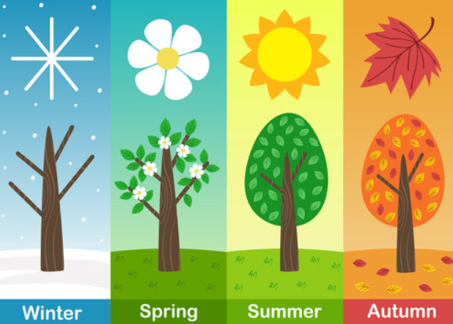
Year 1 – Seasonal changes: Why does the weather change during the different seasons?
Lesson 1 | Lesson 2 | Lesson 3 | Lesson 4 | Lesson 5 | Lesson 6
Key question: What is Spring? | Key question: What is Summer? | Key question: What is Autumn? | Key question: What is Winter? | Key question: How does the day change? | Key question: How can we keep dry in the rain?
Key vocabulary
spring – the season in which plants begin to grow
summer – the warmest season of the year
autumn – the season in which some trees lose their leaves
winter – the coldest season of the year
rain – when water falls from the clouds
sun – the bright sphere in the sky that provides light and warmth
change – when something is different
Overview of learning
Children will learn about the four different seasons. This topic is best done throughout the year in the appropriate season so children can observe the season first hand. The first four lessons cover the four seasons and can be completed in any order.
Misconceptions
Children may not realise that seasons are different across the world. Children will need to understand that the weather associated with the season may not always happen (e.g. it may not always be sunny in summer).
Knowledge And Understanding Objectives
Pupils should be taught to:
observe changes across the four seasons
observe and describe weather associated with the seasons and how day length varies

Slide 7
Year 2

Slide 8
Year 2 – Plants: How do seeds and bulbs grow into healthy plants?
Lesson 1 | Lesson 2 | Lesson 3 | Lesson 4 | Lesson 5
Key question: Which plants can we eat? | Key question: Are all seeds the same? | Key question: What do plants need? | Key question: Where will they grow? | Key question: How do plants grow and change?
Key vocabulary –
plant – a living organism
tree – a woody plant
flower – the seed-bearing part of a plant that is usually surrounded by brightly coloured petals
roots – the part of the plant that attaches into the ground for support and nutrient collection
stem – the main stalk of a plant
leaf – part of a plant that is typically flat and hangs off the stem
seed – a small part of a plant that can grow another plant
bulb – a fleshy base of a plant that can grow another plant
Overview of learning
Children will learn about different seeds and bulbs. They will learn about plants we can eat and begin to gather seeds. They will also look at what plants need to grow and what they need to continue to grow and stay healthy.
Misconceptions
Children may not realise that plants are living things and that they can die. They may think only things with faces and brains are alive.
Children may not know that plants have roots in the ground that help the plant.
Children may think that all seeds look the same, so we need to make sure that we allow them to explore and observe a variety of seeds and bulbs.
Knowledge And Understanding Objectives
Pupils should be taught to:
• observe and describe how seeds and bulbs grow into mature plants
• find out and describe how plants need water, light and a suitable temperature to grow and stay healthy.

Slide 9
Year 2 – Animals including humans: Why do we need to keep healthy?
Lesson 1 | Lesson 2 | Lesson 3 | Lesson 4 | Lesson 5 | Lesson 6 | Lesson 7
Key question: What do humans need? | Key question: What are offspring? | Key question: How do animals change as they grow into adults? | Key question: Do we all grow the same? | Key question: Do we need to exercise? | Key question: What is a healthy diet? | Key question: How can we feel better when we are ill?
Key vocabulary –
basic needs – the things humans need to survive
diet – the food we eat exercise – moving our bodies hygiene - keeping clean
illness – when we do not feel well/ feel sick/ have a disease
medicine – something we might take to feel better
offspring – the babies of an animal
seven basic needs – movement, respiration, sensitivity, growth, reproduction, excretion and nutrition
survive – to live
Overview of learning
Misconceptions
Children will learn about the basic needs that all humans need to survive and live. They will study more closely the importance of exercise, a healthy diet and good hygiene as ways to keep us healthy. They will also look at offspring of different animals and how they develop and change into adults as they grow. Finally, children will also look at ways to keep themselves from becoming ill as well as things they can do if they do become ill.
Children might need a thorough explanation of the difference between a “need” and a “want” – needs are things that humans cannot survive without.
Children may have heard the word diet in a negative way when someone is trying to lose weight. Children need to be told that diet just means the food that someone eats.
Children may not understand that medicine must only be taken when you are ill and a trusted adult has given it to you. Certain medicines might taste nice but you cannot digest them if you are not ill.
Knowledge And Understanding Objectives
Pupils should be taught to:
• notice that animals, including humans, have offspring which grow into adults
• find out about and describe the basic needs of animals, including humans, for survival (water, food and air)
• describe the importance for humans of exercise, eating the right amounts of different types of
food, and hygiene.

Slide 10
Year 2 – Living things and their habitats: How do we know something is alive?
Lesson 1 | Lesson 2 | Lesson 3 | Lesson 4 | Lesson 5 | Lesson 6
Key question: Is it living, dead or never been alive? | Key question: What is a microhabitat? | Key question: How are habitats different around the world? | Key question: What conditions do woodlice prefer? | Key question: How are living things adapted to their habitat? | Key question: What is a food chain?
Key vocabulary –
alive – something that is living
dead – something that was living but is not anymore
living – something that is alive
habitat – the place in which a living thing lives
microhabitat – a small habitat
conditions – the state of something
adapted – how something is adjusted
food chain – a series of living things that feed from each other
omnivore – an animal that eats both plants and meat
herbivore – an animal that just eats plants
carnivore – an animal that just eats meat
Overview of learning
Misconceptions
Children will learn about living things and their habitats. They will start the unit of work looking at whether things are living, dead or have never been alive. They will then look at microhabitats and larger habitats identifying some animals that may live there. Children will then conduct an investigation to see which type of conditions woodlice prefer in their habitat. After that they will look at how living things are adapted to their environment. Finally they will look at food chains within habitats.
Children may not fully understand that some of the food we eat used to be living animals that are now dead.
Children may have misconceptions about where animals live as they may have only seen some of these animals in the zoo so might not realise where their habitat would be in the wild.
Knowledge And Understanding Objectives
Pupils should be taught to:
• explore and compare the differences between things that are living, dead, and things that have never been alive
• identify that most living things live in habitats to which they are suited and describe how different habitats provide for the basic needs of different kinds of animals and plants, and how they depend on each other
• identify and name a variety of plants and animals in their habitats, including micro-habitats
• describe how animals obtain their food from plants and other animals, using the idea of a simple food chain, and identify and name different sources of food.

Slide 11
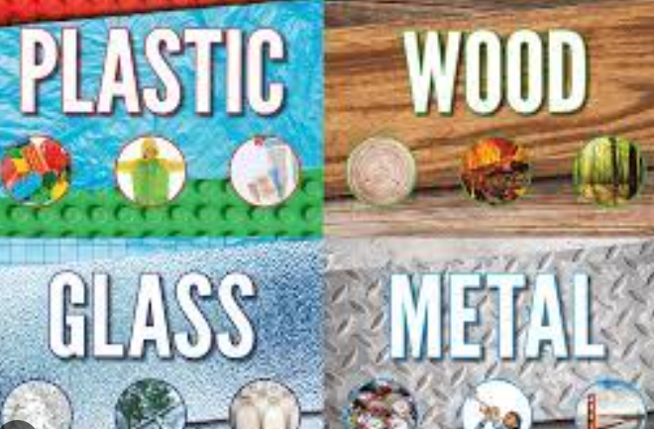
Year 2 – Uses of materials: How are materials chosen in design?
Lesson 1 | Lesson 2 | Lesson 3 | Lesson 4 | Lesson 5
Key question: What are materials? | Key question: What are things made from? | Key question: Which material should the pigs make their house from? | Key question: Which material will protect Humpty Dumpty? | Key question: How can we change materials?
Key vocabulary –
material
Types of material such as:
wood, metal, plastic, glass, rubber, rock, fabric, paper and brick
Words to describe materials such as:
hard, soft, rough, bumpy, smooth, fragile, strong, heavy, light
Overview of learning
Misconceptions
Children will learn about different everyday materials such as wood, metal, plastic, glass, rubber, rock, fabric, paper and brick. They will identify the properties of these materials and conduct investigations to explore how different materials are better suited for different objects through well-known stories. Children will also explore how some of these materials can be changed by squashing, bending, twisting and stretching them.
Children may think of the word ‘material’ meaning fabric. Children need to know that material refers to the matter from which something is made.
Children may also have misconceptions about different materials. They may think that if something is hard then it must be strong or if something is soft then it must be fragile. Glass is hard but very fragile whilst fabric is soft but can be strong.
Knowledge And Understanding Objectives
Pupils should be taught to:
identify and compare the suitability of a variety of everyday materials, including wood, metal, plastic, glass, brick, rock, paper and cardboard for particular uses
find out how the shapes of solid objects made from some materials can be changed by squashing, bending, twisting and stretching.

Slide 12
Year 3

Slide 13
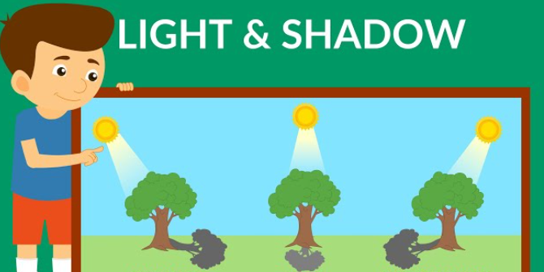
Year 3 – Light: What is light?
Lesson 1 | Lesson 2 | Lesson 3 | Lesson 4 | Lesson 5 | Lesson 6
Key question: What is a light source? | Key question: What is reflected light? | Key question: Is the sun dangerous? | Key question: What is a shadow? | Key question: Does moving the light source above the object change a shadow? | Key question: How do mirrors work?
Key vocabulary –
light source - something that emits light
dark - the absence of light
reﬂect - a surface (or body) that throws back light without absorbing it
shadow - an area where direct light from a light source cannot reach due to obstruction by an object
opaque - opaque materials do not let any light pass through them. They block the light
translucent - translucent materials let some light through, but scatter the light in all directions so that they cannot see clearly through them
transparent - transparent materials let light pass through them in straight lines so that you can see clearly through them
luminous - giving off light, bright or shining
Overview of learning
Children will recognise that they need light in order to see things and that dark is the absence of light. They will learn to identify light sources; explore what happens when light reﬂects off mirrors or other reﬂective materials and think of ways to protect themselves from the Sun. They will investigate which materials make the best/worst shadows and conduct an experiment to ﬁnd out about the relationship between the height of a light source and the length of a shadow. Children will also experience a range of activities to discover how mirrors work.
Misconceptions
Children may think that the Moon and other shiny/reﬂective objects are light sources as they appear to shine however, they are not. The Moon reﬂects light from the Sun (it does not give off its own light)
and cat’s eyes, mirrors, reﬂective material on clothing also only reﬂect light (they are not light sources).
Children may think that you see things because light comes out of your eyes.
Misconceptions about shadows often centre around the position of the object, light source and shadow. The shadow always forms on the opposite side of the object from the light source; the shadow is a
similar shape as the object and the base of the shadow always touches the object..
Knowledge And Understanding Objectives
Pupils should be taught to:
-recognise that they need light in order to see things and that dark is the absence of light
-notice that light is reﬂected from surfaces
-recognise that the Sun can be dangerous and that there are ways to protect their eyes
-recognise that shadows are formed when the light from a light source is blocked by a solid object
-ﬁnd patterns in the way that the size of shadows change

Slide 14
Year 3 – Animals including humans: How do the systems inside our body work to make a healthy human?
Lesson 1 | Lesson 2 | Lesson 3 | Lesson 4 | Lesson 5
Key question: How does our skeleton help us? | Key question: Do our bones affect what we can do? | Key question: What do our muscles do? | Key question: Do all animals have the same skeleton? | Key question: What types of nutrition do we need?
Key vocabulary –
nutrition – food or nourishment
skeleton – the framework of bones that supports the body of an animal
muscles – a bundle of tissue in the body of an animal that can contract enabling movement
healthy – good for your health
unhealthy – not good for your health
diet – the food that an animal eats
bones – a solid part of the skeleton
vertebrate – an animal with a backbone (spine)
invertebrate - an animal without a backbone (spine)
Overview of learning
Children will learn about the structure of the human skeleton and how the muscles also work alongside the skeleton to support and protect the human body. They will then look at how skeletons differ in different animals. Finally, children will look at nutrition and the importance of eating a healthy diet.
Misconceptions
Children may have misconceptions about the bones in our body and where they are. They may think we have fewer bones and that the bones do not cover our whole body.
Children may also think that animals have the same skeleton as humans.
Children may have misconceptions about muscles. Some children think that only males have muscles but children need to understand that all humans have muscles in order to move.
Children may have misconceptions about the word diet. We need to explain that a diet just means what an animal eats e.g. a shark’s diet is smaller fish. Some children may have heard this term used when people want to lose weight.
Knowledge And Understanding Objectives
Pupils should be taught to:
identify that animals, including humans, need the right types and amount of nutrition, and that they cannot make their own food; they get nutrition from what they eat.
identify that humans and some other animals have skeletons and muscles for support, protection and movement.

Slide 15
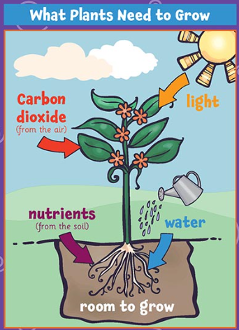
Year 3 – Plants: How does each part of the plant fulfil its function?
Lesson 1 | Lesson 2 | Lesson 3 | Lesson 4 | Lesson 5 | Lesson 6
Key question: What do plants need? | Key question: Do the different parts of the plant have a function? | Key question: What are roots? | Key question: How do plants transport water? | Key question: How do plants reproduce? | Key question: How are seeds dispersed?
Key vocabulary –
plant – a living organism
tree – a woody plant
flower – the seed bearing part of a plant that is usually surrounded by brightly coloured petals
roots – the part of the plant that attaches into the ground for support and nutrient collection
stem – the main stalk of a plant
leaf – part of a plant that is typically flat and hangs off the stem
seed – a small part of a plant that can grow another plant
bulb – a fleshy base of a plant that can grow another plant
nutrients – something that provides nourishment to a living thing
pollination – the transfer of pollen to allow fertilisation
formation – to create
dispersal – to distribute or spread over a wide area
Overview of learning
Misconceptions
During this unit of work, children will build upon their previous knowledge of plants and trees from Year 2 where children find out what plants need in order to stay healthy once they have grown. Throughout this topic, children will be creating a booklet. They will identify and describe the functions of the different parts of plants. They will explore what plants need for life and growth. Children will then complete an investigation to see how water is transported through plants. Children will also look at seeds and explore the different ways that plants disperse their seeds.
Children may not realise that plants are living things and that they can die. They may only think things with faces and brains are alive.
Children may not know that plants have roots in the ground that help the plant.
Children may think that all seeds look the same so we need to make sure that we allow them to explore and observe a variety of seeds and bulbs.
Knowledge And Understanding Objectives
Pupils should be taught to:
identify and describe the functions of different parts of flowering plants: roots, stem/trunk, leaves and flowers
explore the requirements of plants for life and growth (air, light, water, nutrients from soil, and room to grow) and how they vary from plant to plant
investigate the way in which water is transported within plants
explore the part that flowers play in the life cycle of flowering plants, including pollination, seed formation and seed dispersal.

Slide 16
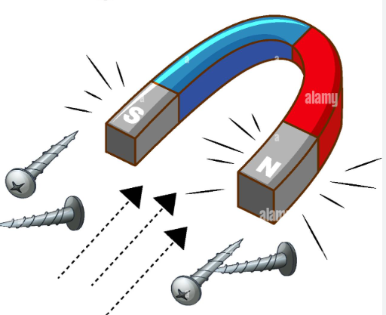
Year 3 – Forces and Magnets: How do magnets work?
Lesson 1 | Lesson 2 | Lesson 3 | Lesson 4 | Lesson 5 | Lesson 6
Key question: What is a force? | Key question: Do objects move the same on different surfaces? | Key question: How do magnetic forces work? | Key question: Which materials are magnetic? | Key question: Do magnets attract each other? | Key question: Are all magnets the same strength?
Key vocabulary –
force – a push, pull, twist or turn caused when two objects interact with each other
magnet – an object or device that attracts iron or another magnetic material
contact – touching
non-contact – not touching
attract – pull towards
repel – push away
magnetic– attracted to a magnet
non-magnetic – not attracted to a magnet
iron – a metal that can be made into a magnet
Overview of learning
Misconceptions
Children will explore simple pushes and pulls as an introduction to forces. They will explore how the texture of an object or the surface it is on can affect how the object moves. They will then explore pushes and pulls further by investigating different magnets and how they can pull (attract) and push (repel) at a distance without contact.
Children may think that all metals are magnetic. This is false, as only iron, nickel and cobalt are magnetic. Children might think that all silver-coloured objects are attracted to a magnet. This is not true, as aluminium is silver in colour but is not attracted to a magnet.
Children might think that bigger magnets are stronger than smaller magnets.
This is not true, as the size of the magnet is not directly related to its strength.
Knowledge And Understanding Objectives
Pupils should be taught to:
Compare how things move on different surfaces.
Notice that some forces need contact between two objects, but magnetic forces can act at a distance.
Observe how magnets attract or repel each other and attract some materials and not others.
Compare and group a variety of everyday materials together based on whether they are attracted to a magnet and identify some magnetic materials.
Describe magnets as having two poles.
Predict whether two magnets will attract or repel each other, depending on which poles are facing.

Slide 17
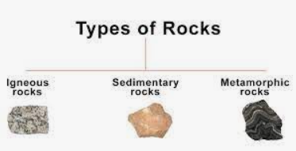
Year 3 – Rocks and soils: How can we classify rocks?
Lesson 1 | Lesson 2 | Lesson 3 | Lesson 4 | Lesson 5 | Lesson 6
Key question: What ire rocks? | Key question: Are all rocks the same? | Key question: How are rocks formed? | Key question: Which rocks make up Earth? | Key question: What are soils? | Key question: How are fossils formed?
Key vocabulary –
rock – a solid material that makes up the surface of the Earth
soil – a black or dark brown material on the upper layer of the Earth where plants grow
fossil – the remains of a prehistoric animal embedded in rock
appearance – what something looks like
physical
properties – a characteristic of an object
igneous rock – rock formed through the cooling and solidification of magma or lava
sedimentary rock – rock formed from sediments that have settled at the bottom of a lake, sea or ocean and have been compressed together over millions of years.
metamorphic rock – rock formed from other rocks that are changed because of heat or pressure
Overview of learning
Misconceptions
Children will explore different rocks and soils. They will classify and group together rocks based on their appearance as well as their physical properties. They will learn how the Earth is made up of different rocks and fossils and begin to explain how some of the different rocks are formed. Children will also look at fossils, what they are and how they are formed in rock.
Children may think that all rocks are the same and all soils are the same.
Children may not know that rocks are formed over time, they might just think that they have always been there.
Children may not think that the Earth is made fully of different types of rock.
Children may struggle to grasp that the centre of the Earth is molten rock as they will only understand rocks as being hard and strong.
Knowledge And Understanding Objectives
Pupils should be taught to:
compare and group together different kinds of rocks on the basis of their appearance and simple physical properties
describe in simple terms how fossils are formed when things that have lived are trapped within rock
recognise that soils are made from rocks and organic matter.

Slide 18
Year 4

Slide 19
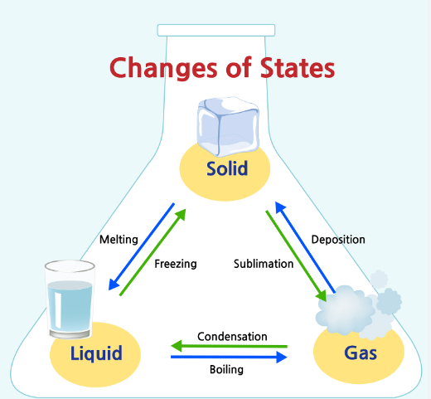
Year 4 – States of matter: How can we classify rocks?
Lesson 1 | Lesson 2 | Lesson 3 | Lesson 4 | Lesson 5 | Lesson 6
Key Question: What are solids, liquids and gases? | Key Question: Do all liquids behave the same? | Key Question: How do materials change state? | Key Question: What is the water cycle? | Key Question: Do all liquids evaporate? | Key Question: Does temperature affect the rate of evaporation?
Key vocabulary –
change - to make different
collection - when water flows back into rivers, streams and lakes and gets carried back to sea
condensation - when water vapour cools and turns back into water
evaporation - when water is heated and turns into water vapour
freeze - when something is put at a very low temperature
gas - a state of matter that has no defined shape or volume
heat - when something is put at a hot temperature
liquid - a state of matter that flows freely but keeps the same volume
precipitation - when water falls from the clouds in the sky
property - a characteristic
solid - a state of matter that is firm and stable
temperature - how hot or cold something is
thermometer - an instrument used for measuring temperature
Overview of learning
Misconceptions
Children will learn to compare and group materials according to whether they are solids, liquids or gases. They will learn that some materials change state when they are heated or cooled and be able to identify and name these processes as melting, freezing, evaporating or condensing. They will learn about the water cycle and be able to identify the part played by evaporation and condensation in the water cycle.
Children will work scientifically to plan and conduct investigations involving melting and evaporation. They will learn to associate the rate of evaporation with temperature.
Children may think that all gases smell. This is not true; some gases do smell but not all.
Children may confuse steam with water vapour. Children may also think that clouds are a gas. This is not true; clouds are droplets of water that have condensed around dust particles.
Children find condensation difficult to explain. It is important to point out everyday examples of condensation throughout the school year e.g why is there water on the inside of the windows? How did the water get there?
Knowledge And Understanding Objectives
Pupils should be taught to:
compare and group materials together, according to whether they are solids, liquids or gases
observe that some materials change state when they are heated or cooled, and measure or research the temperature at which this happens in degrees Celsius (°C)
identify the part played by evaporation and condensation in the water cycle and associate the rate of evaporation with temperature.

Slide 20
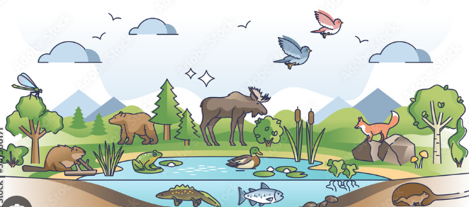
Year 4 – Living things and their habitats: Which living things can be found in the local area?
Lesson 1 | Lesson 2 | Lesson 3 | Lesson 4 | Lesson 5 | Lesson 6
Key question: What are the seven life processes? | Key question: How can we sort and group animals? | Key question: What are vertebrate animals? | Key question: Which living things can be found in the local area? | Key question: What is a classification key? | Key question: How is our environment changing?
Key vocabulary –
environment – the conditions (both living and non-living) that surround an organism
classify – to arrange a group of people or things in classes or categories according to shared qualities or characteristics
vertebrate – an animal that has a backbone
invertebrate – an animal without a backbone
exoskeleton – a rigid external covering for the body in some invertebrate animals
key – a questioning device that allows the progressive narrowing down of the classification of an unknown living thing based on observable or testable features
adaptation – the way in which an organism is particularly suited to its environment
pollution – the introduction into the environment of a substance which has harmful effects
Overview of learning
Misconceptions
During this unit of work, children will learn to recognise the seven life processes common to all living things. They will learn to sort living things using a variety of criteria and extend their use
of scientific vocabulary to describe features and characteristics of animals and plants.
They will conduct a local habitat search and learn to identify unknown living things using a classification key. Children will consider how environmental change impacts the local area and suggest ways in which humans can prevent further damage.
Snakes have exoskeletons that they shed. This is not true; snakes are vertebrate animals that shed their skin (not an exoskeleton).
Children may think fish breathe in water; however, it is not water that the fish take in when they breathe but the oxygen mixed in with the water.
Children may assume that all changes to habitats are negative.
Children may find it difficult to distinguish the difference between reptiles and amphibians.
Knowledge And Understanding Objectives
Pupils should be taught to:
recognise that living things can be grouped in a variety of ways
explore and use classification keys to help group, identify and name a variety of living things in their local and wider environment
recognise that environments can change and that this can sometimes pose dangers to living things.

Slide 21
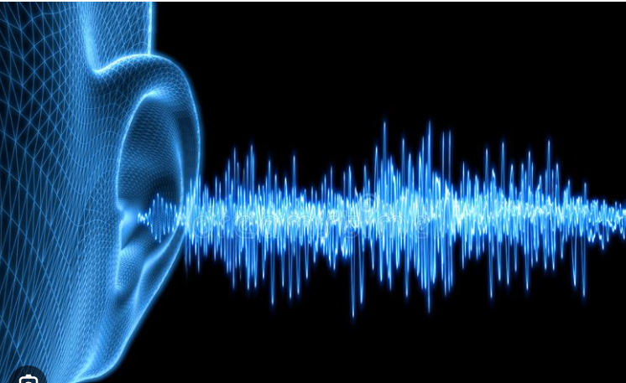
Year 4 – Sound: What is sound?
Lesson 1 | Lesson 2 | Lesson 3 | Lesson 4 | Lesson 5 | Lesson 6 | Lesson 7
Key question: How are sounds made? | Key question: What is a sound vibration | Key question: What is inside your ears? | Key question: What is volume? | Key question: What is pitch? | Key question: Does the size of the pinna affect the volume of sound? | Which material is best at muffling sound?
Key vocabulary –
Vibrate/vibrations - forward and backward movement of an object (usually rapidly).
volume - how loud or quiet a sound is.
pitch - how high or low a sound is.
pinna - the outer portion of the ear (ear flap).
cochlea - the sound reception part of the inner ear.
ear drum - the membrane which collects sound from the pinna and passes it to the inner ear.
Overview of learning
Misconceptions
Children will learn how vibrations cause sounds and how sounds travel through different mediums at different speeds. They will explore how sounds can change in pitch and loudness and be able to explain this using scientific language. They will develop their scientific skills by planning two fair test investigations to answer the questions: which material is the best at muffling sounds and does the size of the pinnae affect the volume of the sound? Children will also learn what happens to sound vibrations when they reach the ear.
Children will often confuse volume with pitch. The vocabulary needs to be exemplified carefully (and frequently) to ensure correct usage.
You can see and hear a distant event at the same moment – this in not true. Light travels faster than sound (hence you see lightning then hear thunder even though they have occurred at the same time).
Hitting an object harder gives a higher pitch – this is not true; hitting an object harder will produce a louder sound as the vibrations created are stronger but won’t affect the pitch.
Sound moves faster in air than in solids (air is "thinner" and forms less of a barrier) - this is not true. Sound moves faster through solids as the particles are closer to one another. As sound waves move, the air moves along with them. This is not true. The vibration is passed from air particle to the next air particle.
Knowledge And Understanding Objectives
Pupils should be taught to:
identify how sounds are made, associating some of them with something vibrating
recognise that vibrations from sounds travel through a medium to the ear
find patterns between the pitch of a sound and features of the object that produced it
find patterns between the volume of a sound and the strength of the vibrations that produced it
recognise that sounds get fainter as the distance from the sound source increases.

Slide 22
Year 4 – Animals including humans: What happens to the food that we eat?
Lesson 1 | Lesson 2 | Lesson 3 | Lesson 4 | Lesson 5
Key question: What is the digestive system? | Key question: Why are teeth different shapes? | Key question: Which drink causes the most teeth decay? | Key question: What is a food chain? | Key question: What is the food chain game?
Key vocabulary –
Canines – ripping teeth
Carnivore – animals that only eat other animals
Digestion – the process of breaking down food into simple chemicals for the body to absorb
Herbivore – animals that only eat plants
Incisor – cutting teeth
Large intestines – where water is absorbed into the blood
Molars – grinding teeth
Oesophagus – food and water pipe
Omnivore – animals that eat both plants and animals
Peristalsis – muscular action to move food along the digestive tubes
Predator – an animal that hunts, kills and eats other animals for food
Prey – a term used to describe organisms that predators kill for food Producer – a plant in a food chain
Saliva – a lubricating digestive juice produced in the mouth
Small intestines – where food is broken down and nutrients are absorbed into the blood
Stomach – a rounded vessel in the body where acid and digestive juices break down food
Overview of learning
Misconceptions
Children will learn about the importance of the digestive system. They will learn the names and functions of each part of the system and be able to identify the different types of teeth in humans and their purpose. The children will plan and conduct an investigation to answer the question: which drink causes the most tooth decay? They will extend their knowledge of food chains by constructing and interpreting a variety of food chains, identifying producers, predators and prey.
Children may think that their stomach is where their belly button is and that all food is digested there. However, although some simple foods such as sugar are digested, most foods travel to the small intestine for further digestion and to be absorbed into the blood.
Children may think that food goes down one tube and liquids go down another. They may also think that the air we breathe goes down the same tube as the food and water.
When drawing food chains, children may get confused by the direction of the arrow.
Knowledge And Understanding Objectives
Pupils should be taught to:
describe the simple functions of the basic parts of the digestive system in humans
identify the different types of teeth in humans and their simple functions
construct and interpret a variety of food chains, identifying producers, predators and prey

Slide 23
Year 4 – Elctricity: What is electricity?
Lesson 1 | Lesson 2 | Lesson 3 | Lesson 4 | Lesson 5
Key question: Which appliances use electricity? | Key question: How can I make a simple circuit? | Key question: Why don’t some circuits work? | Key question: How can we test if a material is a conductor or an insulator? | Key question: How do switches affect a circuit?
Key vocabulary –
appliance – a device or piece of equipment that has been made to perform a specific task
battery – a small item used to power small appliances
circuit – a route through which electricity flows components – the parts of a circuit
conductor – allows electricity to flow through it
current – the rate of flow of electricity measured in amps
electrical – something that uses electricity to work
insulator – doesn’t allow electricity to flow through it mains
power – electricity provided by power stations portable – can be easily carried around
pylon – a tower used for keeping electrical wires above the ground
switch – a device for controlling the flow of electricity in a circuit
Overview of learning
Misconceptions
Children will learn to sort common electrical appliances into battery and mains powered. They will construct simple series circuits containing a variety of components and understand the difference between complete and incomplete circuits. They will be able to identify whether or not a bulb will light in a simple series circuit and put forward ideas to fix incomplete circuits. The children will plan and conduct an investigation to discover which materials make good insulators and design, construct and test their own switches.
When making their own circuits, it is a common error that the arms of the split pins touch at the back therefore allowing electricity to flow around the circuit. This would mean you wouldn’t be able to turn the bulb on and off using the paper clip as a switch. It would just be constantly on.
Children may confuse thermal conductors and insulators with electrical conductors and insulators. Thermal means relating to heat.
Some children may think that electricity is only bought from a shop. Although batteries are, children need to be taught that mains electricity comes to our homes in cables from a PowerStation.
Children may think that the bigger the battery, the more electricity is contained in it and will make a bulb shine brighter. Although it is true to say a battery’s voltage does affect the brightness of a bulb, the size of the battery isn’t always related to the voltage e.g. a 1.5V battery can come in 4 different sizes.
Knowledge And Understanding Objectives
Pupils should be taught to:
identify common appliances that run on electricity
construct a simple series electrical circuit, identifying and naming its basic parts, including cells, wires, bulbs, switches and buzzers
identify whether or not a lamp will light in a simple series circuit, based on whether or not the lamp is part of a complete loop with a battery
recognise that a switch opens and closes a circuit and associate this with whether or not a lamp lights in a simple series circuit
recognise some common conductors and insulators, and associate metals with being good conductors.

Slide 24
Year 5

Slide 25
Year 5 – Earth and Space: What is the solar system?
Lesson 1 | Lesson 2 | Lesson 3 | Lesson 4 | Lesson 5 | Lesson 6
Key question: What are the names of the planets in the solar system? | Key question: How do we know the Earth is a sphere? | Key question: How long does it take for Earth (and other planets) to orbit the Sun once? | Key question: What is the largest object that orbits the Earth? | Key question: Why is there day and night on Earth? | Key question: Does the Moon change shape?
Key vocabulary –
orbit – the rotation that one body in space takes around another when under gravitational influence
axis – an imaginary line going through a central body that most bodies in space rotate around
day – length of time the Earth takes to rotate on its axis once
month – the length of time the Moon takes to complete one orbit around the Earth (not exactly equal to a calendar month)
planet – a non-luminous body that orbits a star
solar system – the name given to the Sun and all the bodies orbiting around it
year – the period the Earth takes to complete one orbit of the Sun
gravity – the force of attraction between two masses
Overview of learning
Misconceptions
Children will learn that the Earth is part of the solar system and that the Sun is at the centre of that system. They will learn the names of the other planets (based on their distance from the Sun) and be able to describe the movement of Earth (and other planets) in relation to the Sun. Children will discover why there is day and night on Earth and relate this to time. They will plan an investigation to answer the question - what happens to the Sun during the daytime?
Children will also gain an understanding of the phases of the Moon and be able to describe the Moon’s movement in relation to the Earth
When learning about the order of the planets based on the distance from the Sun, it is important that the children understand that the planets are orbiting around the Sun (they don’t stay in a line from the Sun as often depicted) but the distance away from the Sun stays the same.
When considering day and night, some children may think that the Sun disappears or goes behind a cloud. This is not true; day and night occur as the Earth is rotating on its axis. Because the Sun appears to move across the sky, it can be difficult for the children to comprehend that it is the Earth moving NOT the Sun.
Another common misconception by children is that the Moon actually changes shape (as this is what they observe from Earth) and that there is no gravity on the Moon (The Moon's mass is about 1.2% of the mass of the Earth which makes the gravity on the Moon 83.3% lower than that of the Earth).
Some children may also think that the Moon ‘disappears’ in the daytime however it is still in the sky but the sunlight is too bright (much of the time) to see it. It is useful to have a globe in the classroom to reinforce the fact that the Earth is a spherical body.
Knowledge And Understanding Objectives
Pupils should be taught to:
describe the movement of the Earth, and other planets, relative to the Sun in the solar system
describe the movement of the Moon relative to the Earth
describe the Sun, Earth and Moon as approximately spherical bodies
use the idea of the Earth’s rotation to explain day and night and the apparent movement of the sun across the sky.

Slide 26
Year 5 – Forces and magnets: Are there different types of forces?
Lesson 1 | Lesson 2 | Lesson 3 | Lesson 4 | Lesson 5 | Lesson 6
Key question: What is gravity? | Key question: What is friction? | Key question: Whose shoe has the greatest friction? | Key question: What is air resistance? | Key question: What is water resistance? | Key question: What are gears, levers and pulleys?
Key vocabulary –
Force – a push or pull that acts upon an object that can cause it to move, change shape or change direction.
Friction – the force that acts upon one surface when it moves against another.
Gravity – a pull force that acts at a distance.
Pull – to move something towards.
Push -– to move something away.
Repel – to push away.
Resistance – an opposing or slowing force.
Drag – the frictional force experienced by an object moving through a fluid or air.
Streamlined – a shape which minimises the profile presented by an object in order to minimise the resistance it encounters when moving through a liquid or gas.
Upthrust or buoyancy – the upward force exerted on a body by a fluid that surrounds it, equal and opposite to the weight of the water displaced.
Newton (N) – the unit used to measure force.
Gear –two wheels with serrated or notched rims that mesh together to transfer movement.
Lever – usually a rigid bar with a pivot point close to one end, allowing movement at one end of the lever to be converted into a smaller movement at the other, which effectively magnifies the force applied.
Pulley – a wheel with a grooved rim that allows the transfer of movement via a belt or band.
Overview of learning
Misconceptions
Children will consolidate and extend their knowledge of forces by naming individual forces (e.g. gravity, friction, upthrust). They will extend their knowledge of frictional forces (air resistance and water resistance) and plan fair test investigations to discover which shoe has the greatest friction and which shapes offer the most water resistance. They will learn how forces can be helpful and unhelpful in various scenarios and identify the forces involved in each scenario. They will learn what a mechanism is and how pulleys, levers and gears are used to allow a smaller force to have a greater effect.
The word ‘force’ can have different meanings in the English language e.g. may the force be with you… a forceful character. Many common uses of the word ‘force’ may give children the impression that it is intrinsic to human activity rather than a concept in physical science.
Children may also think that an object needs a constant force to keep it moving; this is true but only because of friction.
Children may think that forces only act in one direction.
Knowledge And Understanding Objectives
Pupils should be taught to:
explain that unsupported objects fall towards the Earth because of the force of gravity acting between the Earth and the falling objects
identify the effects of air resistance, water resistance and friction, that act between moving surfaces
recognise that some mechanisms, including levers, pulleys and gears, allow a smaller force to have a greater effect.

Slide 27
Year 5 – Living things and their habitats: How do living things reproduce and why is this important in a life cycle??
Lesson 1 | Lesson 2 | Lesson 3 | Lesson 4 | Lesson 5 | Lesson 6
Key question: What are the seven life processes? | Key question: How do mammals reproduce? | Key question: Do animals reproduce in the same way? | Key question: How do plants reproduce? | Key question: What is a life cycle? | Key question: What are the stages in a life cycle of a plant?
Key vocabulary –
fertilisation – the point at which the sperm from the pollen meets the egg in the ovary
pollination – the process by which the pollen reaches the stigma
pollen – granule that delivers the male genetic material to the female seed
stamen – the male part of the flower, comprising of the anther and filament
pistil – the female part of the flower consisting of the stigma, style and ovary
seed dispersal – the method used by a plant to spread out its seeds (usually by wind, water or animals)
reproduction – the combining of genetic material from two individuals to produce new life
Overview of learning
Misconceptions
Children will learn the seven life processes that distinguish living from
non-living things. They will consolidate and extend previous learning on the life cycles of plants and animals, comparing and describing differences in the life cycles of mammals, amphibians, reptiles, birds and insects. They will learn how animals and plants reproduce; comparing differences and similarities between five different animal groups.
Children may confuse mating and reproduction. Reproduction is the combining of genetic material from a male and female part to produce new life. Both animals and plants reproduce sexually however animals have to mate in order for them to reproduce.
Children may think that the first stage of each life cycle is the egg; every life cycle begins with the egg. Labelling the 'egg' as the first stage would be incorrect as the stages in a life cycle are repeated and there is no first or last stage.
When discussing how mammals reproduce (and humans in particular) children may think that babies are conceived in the stomach. It is important that the children understand that stomachs are for food, not babies.
Fertilisation takes place naturally in the fallopian tube (oviduct) of the female reproductive system and the fertilised egg, which develops into a ball of cells over time, develops in the uterus (womb) of the female to become a baby.
Knowledge And Understanding Objectives
Pupils should be taught to:
describe the differences in the life cycles of a mammal, an amphibian, a reptile, an insect and a bird
describe the life process of reproduction in some plants and animals.

Slide 28
Year 5 – Animals including humans: How do we change as we grow older?
Lesson 1 | Lesson 2 | Lesson 3 | Lesson 4
Key question: How do humans change throughout their life? | Key question: How do we develop in the womb? | Key question: How do we change through puberty? | Key question: How do humans change as we become senior?
Key vocabulary –
birth – when your life starts as a physically separate being
conception/fertilisation – when the egg and the sperm meet to begin the development of a foetus
death – when the life cycle ends
develop – to grow to become more mature or advanced
egg – the female sex cell
foetus – a baby that is still developing in the womb
puberty – a time in the human life cycle when the body goes through changes to become an adult
sperm – the male sex cell
womb – an organ in which the foetus grows and develops
Overview of learning
Misconceptions
Children may have misconceptions about being an adult and that you stop learning as well as stop growing.
Children will need to understand that our bodies can still change when we are an adult.
Children may know what will change with their body during puberty but may not know about the opposite sex.
Children may also think that a baby grows inside its mother’s stomach where food goes. They will learn about the womb during lesson 2
Children will learn about the different stages of the human life cycle. They will discuss a simple timeline first before going into more depth about what happens in the womb, during puberty and when you are older.
Knowledge And Understanding Objectives
Pupils should be taught to:
describe the changes as humans develop to old age.

Slide 29
Year 5 – Properties and changes in materials: How do materials change?
Lesson 1 | Lesson 2 | Lesson 3 | Lesson 4 | Lesson 5 | Lesson 6 | Lesson 7
Key question: What are the properties of solids, liquids and gases? | Key question: How can I describe the properties of materials? | Key question: Which materials make the best thermal insulators? | Key question: Which materials are magnetic? | Key question: Which materials are soluble and which are insoluble? | Key question: How can mixed materials be separated? | Key question: What is irreversible change?
Key vocabulary –
soluble - a substance that will dissolve in water
insoluble - a substance that will not dissolve in water saturation - the point at which no more solute can be dissolved
solution - a soluble solid is dissolved in liquid to form a solution
filtration - the collection of larger particles in a mixture
boiling - the process by which molecules of a liquid change to vapour (much faster change than evaporation)
condensing - the change of vapour into a liquid evaporation - change from a liquid to a vapour
freezing - the change of a liquid to a solid
melting point - the point at which a solid substance liquefies
chemical change - one where the molecular structures of the combined substances are broken down and recombined to make a new substance
physical change - where the molecular structures of the combined substance stay separate, allowing separation to occur
reversible change - a physical change that we can undo
irreversible change - a physical change that we cannot undo
Overview of learning
Misconceptions
Children will consolidate previous learning by revisiting the properties of solids, liquids and gases; learn to describe the properties of materials using scientific language; investigate which materials make the best thermal insulators; and which materials are magnetic. Children will be introduced to key scientific vocabulary to describe the properties of materials (e.g. soluble and insoluble) and investigate how to separate materials using these properties. They will be able to name separation methods (filtering, sieving, evaporation, magnets) and decide on the most efficient method for separating a mixture of materials. They will be able to describe change as reversible or irreversible
Children often use the word ‘disappear’ when describing dissolving, and teachers often think this is a misconception. However, children may be using the word ‘disappear’ to describe that they can no longer see it BUT understand that the substance is still in the liquid. It is important to ask the children what they mean by using the word ‘disappear’. Whether they think that the soluble substance has gone (i.e. no longer in the water; this is a misconception) or they realise the substance is still in the liquid but, we can’t see it. They need to be encouraged to use the word dissolved to accurately describe what happened.
Knowledge And Understanding Objectives
Pupils should be taught to:
Compare and group everyday materials based on their properties, including their hardness, solubility, transparency, conductivity (electrical and thermal), and response to magnets.
Know that some materials will dissolve in liquid to form a solution, and describe how to recover a substance from a solution.
Use knowledge of solids, liquids and gases to decide how we might separate mixtures, including through filtering, sieving and evaporating.
Give reasons, based on evidence from comparative and fair tests, for the particular uses of everyday materials, including metals, wood and plastic.
Demonstrate that dissolving, mixing and changes of state are reversible changes.
Explain that some changes result in the formation of new materials and that this kind of change is not usually reversible, including changes associated with burning and the action of acid on the bicarbonate of soda.

Slide 30
Year 6

Slide 31
Year 6 – Living things and their habitats: What is classification?
Lesson 1 | Lesson 2 | Lesson 3 | Lesson 4 | Lesson 5 | Lesson 6
Key question: How are animals classified? | Key question: What is a classification key? | Key question: How can we classify plants? | Key question: Is yeast a living microorganism? | Key question: What are the five main groups of microorganisms? | Key question: Who was Carolus Linnaeus?
Key vocabulary –
classify – to arrange a group of people or things in classes or categories according to shared qualities or characteristics
vertebrate – an animal that has a backbone
invertebrate – an animal without a backbone
exoskeleton – a rigid external covering for the body in some invertebrate animals
vascular – plants that use roots and stems to take in water and nutrients
non-vascular – plants that do not use roots and stems to take in water and nutrients
taxonomy – the scientific process of grouping or classifying living organisms
Also explain the terms; herbivore, carnivore, omnivore; the five main animal classification groups (mammals, birds, fish, reptiles and amphibians) and the five main microorganism groups (bacteria, viruses, protozoa, algae and fungi).
Overview of learning
Misconceptions
Children will learn about classification of living things, including microorganisms. They will learn the names and characteristics of the main groups used to classify animals, plants and microorganisms. Children will learn to use a classification key and create their own key using yes/no questions. Children will investigate the question; Is yeast a microorganism? And conduct an experiment involving the respiration of yeast. They will produce a presentation about the life and work of Carolus Linnaeus and understand the importance of his standard classification system.
Some children may think that all microorganisms are harmful and make you ill. It is important to highlight that some microorganisms are useful and play an important part in decomposition.
They may also think that microorganisms are all the same size; however, although all microbes cannot be seen with the naked eye, there is a huge variance in the size of microbes (e.g. in general, viruses are much smaller than bacteria).
Children may think that mushrooms are a type of plant. They are not, they are classified as fungi.
Knowledge And Understanding Objectives
Pupils should be taught to:
describe how living things are classified into broad groups according to common observable characteristics and based on similarities and differences, including microorganisms, plants and animals
give reasons for classifying plants and animals based on specific characteristics.

Slide 32
Year 6 – Animals including humans: How do an animal’s living systems work together to maintain a healthy body?
Lesson 1 | Lesson 2 | Lesson 3 | Lesson 4 | Lesson 5 | Lesson 6
Key question: What is the circulatory system? | Key question: How does our heart work? | Key question: How does exercise affect my heart rate? | Key question: What does the blood transport around the body? | Key question: How can I live a healthy lifestyle? | Key question: What can damage our health?
Key vocabulary –
heart – a muscle that pumps blood around the body
lungs – spongy air filled organs that provide oxygen to the blood
blood – a liquid that carries oxygen, water and nutrients around the body
veins – carry deoxygenated blood to the heart
arteries – carry oxygenated blood away from the heart
heart rate – the number of times our heart beats per minute
Overview of learning
Misconceptions
Children will learn about the importance of the circulatory system and how it transports oxygen around our body. They will learn about the heart and how it is an important muscle in our bodies. Children will learn about their heart rate and different activities that can increase the heart rate. Children will learn about being healthy and things they can do to lead a healthy lifestyle as well as learning about things that people do that can cause them to be unhealthy.
Children may think that oxygenated blood is red whilst blood with no oxygen is blue.
Children need to know that blood is never blue, but some scientific diagrams show it as blue so we can distinguish between the different types of blood.
Children may not realise that exercise is needed to keep the heart healthy and you should aim to complete at least 30 minutes of exercise a day that increases your heart rate.
Knowledge And Understanding Objectives
Pupils should be taught to:
identify and name the main parts of the human circulatory system, and describe the functions of the heart, blood vessels and blood
recognise the impact of diet, exercise, drugs and lifestyle on the way their bodies function
describe the ways in which nutrients and water are transported within animals, including humans.

Slide 33
Year 6 – Light: What is light?
Lesson 1 | Lesson 2 | Lesson 3 | Lesson 4 | Lesson 5 | Lesson 6
Key question: How does light travel? | Key question: Which materials make the best reflectors? | Key question: How does the eye work? | Key question: How do shadows change during the day? | Key question: Why do objects look different in water? | Key question: How do mirrors work?
Key vocabulary –
dark – the absence of light
reflect – a surface (or body) that throws back light without absorbing it
shadow – an area where direct light from a light source cannot reach due to obstruction by an object
opaque – opaque materials do not let any light pass through them. They block the light.
translucent – translucent materials let some light through, but scatter the light in all directions so that they cannot see clearly through them
transparent – transparent materials let light pass through them in straight lines so that you can see clearly through them
luminous – giving off light, bright or shining
scattering – when light is returned from a surface
absorption – when light strikes a surface and is retained within it.
refraction – the “bending” of light when it passes from one transparent material to another.
Overview of learning
Misconceptions
Children will consolidate previous learning by exploring the way that light behaves, including light sources, reflection and shadows. Pupils will make predictions and investigate the relationship between light sources, objects and shadows and understand how the eye works.
Children will extend their experience of light by looking at rainbows, prisms and bending light in water (although they don’t need to explain why these phenomena occur at this stage).
Children may think that the moon and other shiny/ reflective objects are light sources as they appear to shine however, they are not. The Moon reflects light from the Sun (it does not give off its own light) and cat’s eyes, mirrors, reflective material on clothing also only reflect light (they are not light sources).
Children may think that you see things because light comes out of your eyes. Misconceptions about shadows often centre around the position of the object, light source and shadow. The shadow always forms on the opposite side of the object from the light source; the shadow is a similar shape as the object and the base of the shadow always touches the object.
Knowledge And Understanding Objectives
Pupils should be taught to:
recognise that light appears to travel in straight lines
use the idea that light travels in straight lines to explain that objects are seen because they give out or reflect light into the eye
explain that we see things because light travels from light sources to our eyes or from light sources to objects and then to our eyes
use the idea that light travels in straight lines to explain why shadows have the same shape as the objects that cast them

Slide 34
Year 6 – Electricity: What is electricity?
Lesson 1 | Lesson 2 | Lesson 3 | Lesson 4 | Lesson 5
Key question: How do I draw a scientific diagram of a circuit? | Key question: How does voltage in a circuit affect the brightness of a bulb? | Key question: How do I plan a fair test experiment to investigate variations in how components function? | Key question: How do I write a conclusion for my investigation? | Key question: What is renewable and non-renewable energy?
Key vocabulary –
appliance – a device or piece of equipment that has been made to perform a specific task
battery – a small item used to power small appliances
circuit – a route through which electricity flows
components – the parts of a circuit
conductor – allows electricity to flow through it
electrical – something that uses electricity to work
insulator – doesn’t allow electricity to flow through it
mains power – electricity provided by power stations
pylon – a tower used for keeping electrical wires above the ground
renewable energy – energy from a source that is not depleted when used, such as wind or solar power
non-renewable energy – energy from a source that is depleted when used, such as coal, gas and oil
Overview of learning
Misconceptions
Children will consolidate and extend previous learning from year 4 by constructing simple series circuits and drawing them using scientific symbols. They will conduct investigations to determine how the voltage in a circuit affects the brightness of a bulb. They will use their ‘working scientifically’ skills to plan an experiment to investigate variations in how components function and use the results to write a clear and concise conclusion. They will use the internet to research information about renewable and non-renewable energy sources and communicate this information in the form of a leaflet
When adding several components to a circuit, children may think that the bulb is the brightest or the first buzzer makes the most noise. This misconception often arises from the idea that electricity comes out of the battery so the first is the brightest and the last is the dimmest. In fact, all the bulbs would be the same level of brightness (the electricity is ‘shared’ between the components).
When making a circuit with different coloured wires, the children may ‘wrongly’ assume that the different coloured wires have different properties.
Children may think that the bigger the battery, the more electricity is contained in it and will make a bulb shine brighter. Although it is true to say a battery’s voltage does affect the brightness of a bulb, the size of the battery isn’t always related to the voltage e.g. a 1.5V battery can come in 4 different sizes.
Knowledge And Understanding Objectives
Pupils should be taught to:
associate the brightness of a lamp or the volume of a buzzer with the number and voltage of cells used in the circuit
compare and give reasons for variations in how components function, including the brightness of bulbs, the loudness of buzzers and the on/off position of switches
use recognised symbols when representing a simple circuit in a diagram

Slide 35
Year 6 – Evolution: What is evolution?
Lesson 1 | Lesson 2 | Lesson 3 | Lesson 4 | Lesson 5 | Lesson 6
Key question: How are plants adapted to their environment? | Key question: How are animals adapted to their environment? | Key question: What is natural selection and how does this lead to evolution? | Key question: How do adaptations lead to evolution? | Key question: What characteristics can you inherit from your parents? | Key question: How can fossils help us explain evolution?
Key vocabulary –
Adaptation- When a plant or animal has changed in some way, usually over a long period of time, to be better suited to the environment in which they live.
Environment- the conditions that surround an organism.
Evolution- the process by which different kinds of living organisms are believed to have developed from earlier forms during the history of the Earth.
Gene- A unit of heredity which is transferred from a parent to offspring and is held to determine some characteristics of the offspring.
Natural selection- When the fittest, most adapted organisms survive and multiply whilst the least adapted die out.
Inheritance- the reception of genetic qualities by transmission from parent to offspring.
Organism- an individual animal, plant or single-celled life form.
Species- a group of similar organisms that are able to reproduce.
Overview of learning
Misconceptions
Children will explore how animals and plants are adapted to the environment in which they live. They will learn that adaptations occur over time and that may lead to a species evolving. Children will conduct an experiment to answer the question; which beak is best adapted to pick up a seed? They will consider how certain adaptations occur in response to environmental conditions. They will learn about natural selection and how this links to inheritance and how some characteristics are inherited from parents and some are not. Children will consolidate previous learning on fossilisa- tion and understand how studying fossils has helped explain the theory of evolution.
That evolution happens quickly and that individual species adapt rapidly to changes in their environment. This is not the case, evolution happens over time.
Children think that if you believe in evolution then you can’t believe in God; however many evolution scientists also believe in God and have a religious background. Just because you believe in one, doesn't mean you can't believe in the other.
Children may have heard that humans came from monkeys. Humans do belong to the same family as the great apes and the closest known living relative to Homo sapiens is the chimpanzee. However, this does not mean humans 'evolved from monkeys'.
Humans share a common ape-like ancestor with old world monkeys and have very little connection to new world monkeys, which branched off the phylogenetic tree nearly 40 million years ago.
Knowledge And Understanding Objectives
Pupils should be taught to:
recognise that living things have changed over time and that fossils provide information about living things that inhabited the Earth millions of years ago
recognise that living things produce offspring of the same kind, but normally offspring vary and are not identical to their parents
identify how animals and plants are adapted to suit their environment in different ways and that adaptation may lead to evolution

