Slide 1

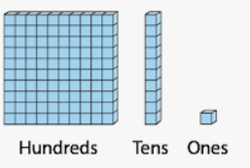
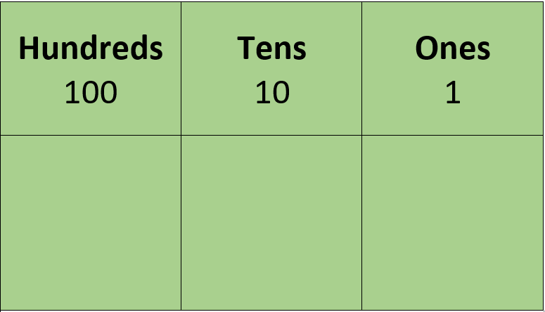
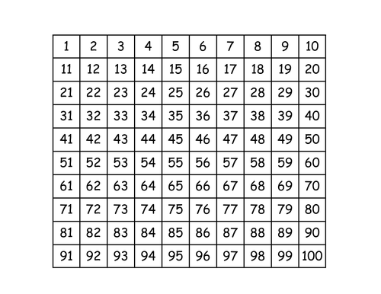
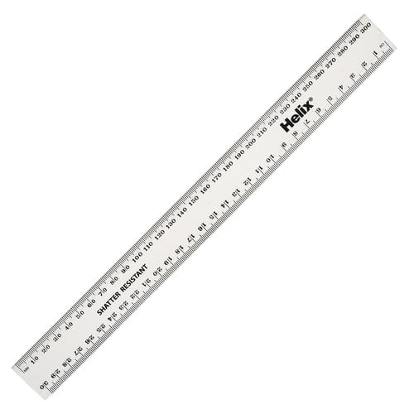
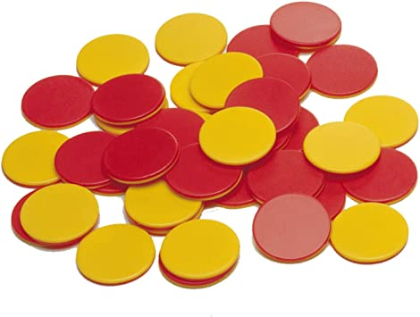
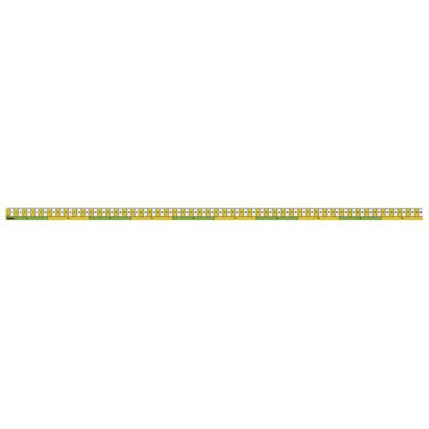
Resources we use in Maths

Slide 3
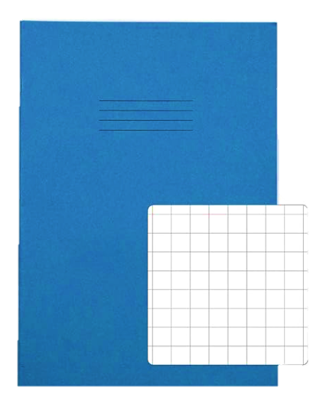

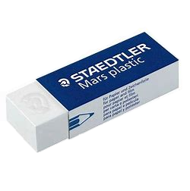
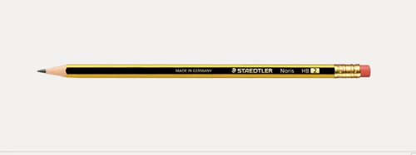
What I need to have ready…

Slide 4
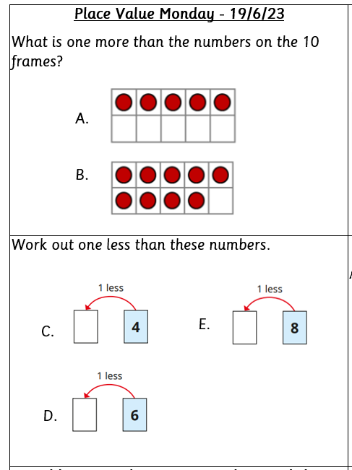
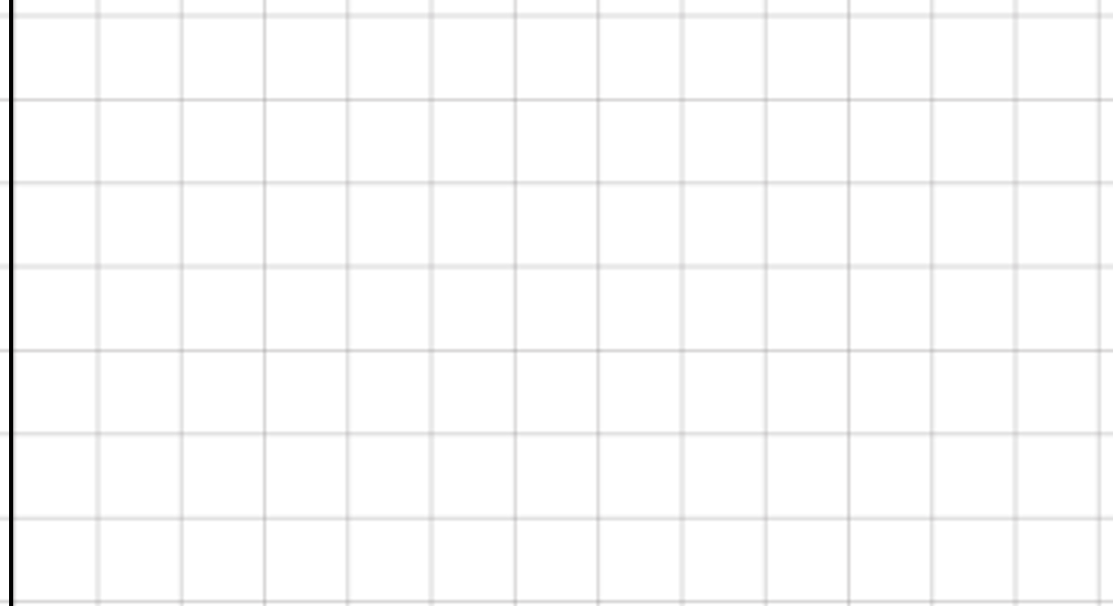
Complete the following in your small Maths Fluency Books please
Remember a digit per box!
A.
1
0

Slide 5
Recap
What did we learn in our last lesson?
3
8
<
6

Slide 6
WALT: Order numbers to 10.

Slide 7
Vocabulary
order
most
Greatest
smallest
fewest
same

Slide 8




Need to know
Are there more red or green cubes?
Write $<$, $>$ or $=$ in the circles.
4 6
4 2
2 6

Slide 9
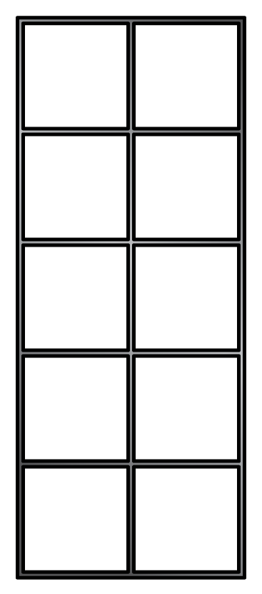




Need to know
Are there more red or green cubes?
Write $<$, $>$ or $=$ in the circles.
4 6
4 2
2 6
green
$$<$$
$$>$$
$$<$$

Slide 10

Teach it
What do you notice?
5 9 3
9
5
3
greatest
smallest

Slide 11
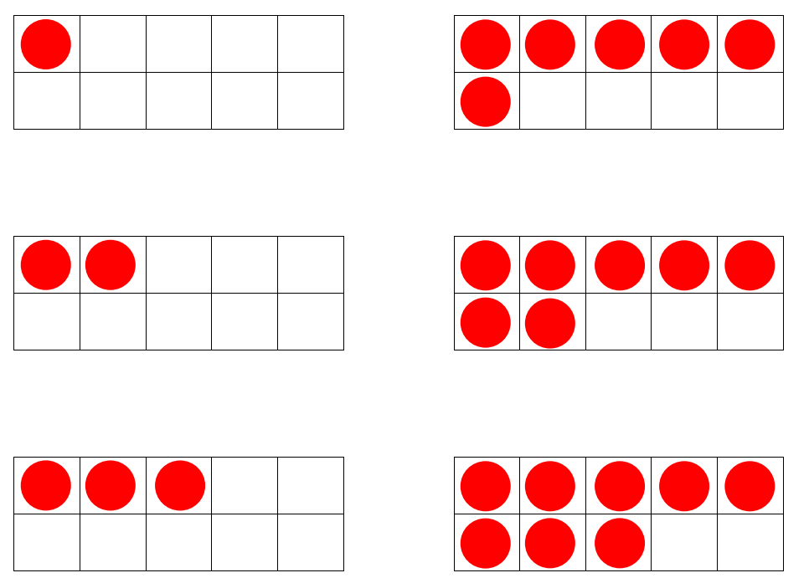
Teach it
Write the numbers in order
from greatest to smallest.
greatest
smallest
0 | 1 | 2 | 3 | 4 | 5 | 6 | 7 | 8 | 9 | 10

Slide 12
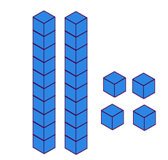


Teach it
Write the numbers in order
from smallest to greatest.
smallest
greatest
0 | 1 | 2 | 3 | 4 | 5 | 6 | 7 | 8 | 9 | 10

Slide 13
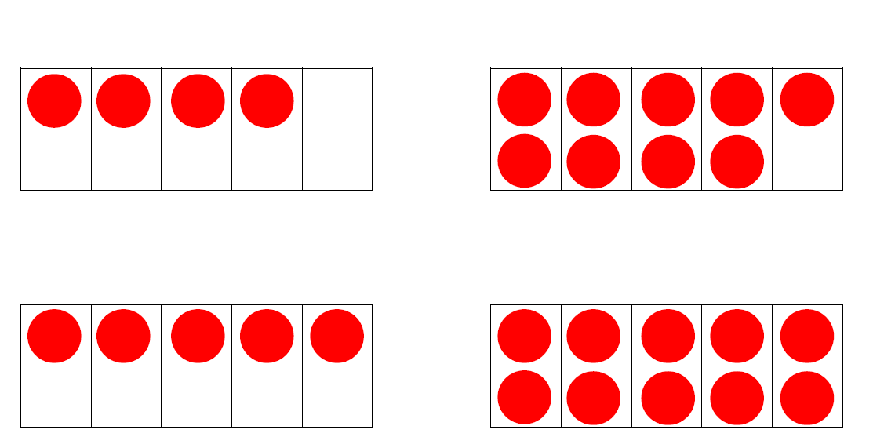

Guided practice
On your whiteboard write these numbers in order.
smallest
greatest
greatest
smallest

Slide 14

Teach it
1, 8, 5
greatest
0, 1, 8
greatest

Slide 15
Guided practice
9, 4, 2
greatest
On your whiteboard write these numbers in order.
3, 7, 10
greatest

Slide 16
Discuss it
What could the missing number be?
9
5
greatest

Slide 17
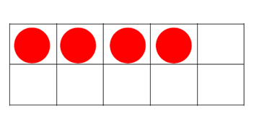
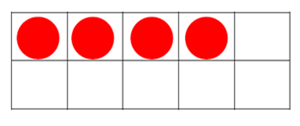

Plenary
True or False?
Miss Catterall has ordered these numbers from smallest to greatest?
greatest

