Slide 1
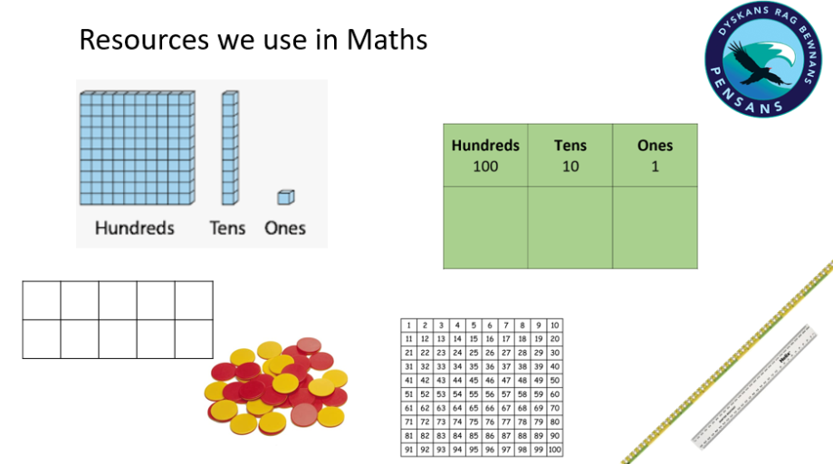
WALT: order and compare numbers

Slide 3
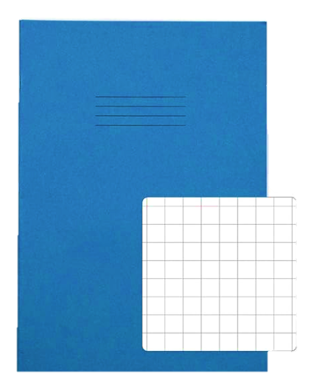

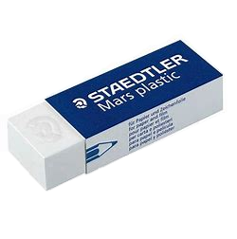
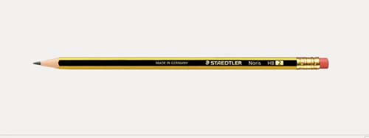
What I need to have ready …

Slide 4
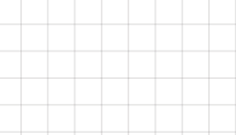
WALT: order and compare numbers
One digit in each square !
4
3
4 0
3

Slide 5
Vocabulary
Hundreds
100s
Ones
1s
Tens
10s
Fewer
More
Less than
Greater than
Compare
Order

Slide 6
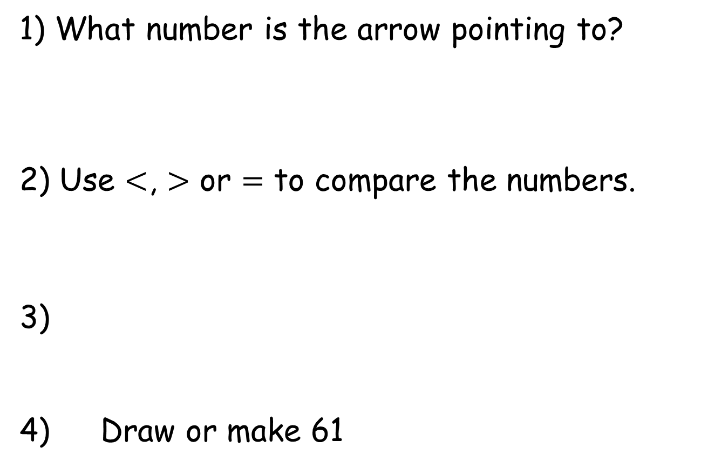
Need to know :
1) What number is the arrow pointing to?
2) Use $<$, $>$ or $=$ to compare the numbers.
3)
4) Draw or make 61
35
45
55
65
83
88
WALT: order and compare numbers

Slide 7
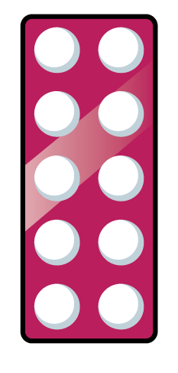



Need to know :
1) What number is the arrow pointing to?
2) Use $<$, $>$ or $=$ to compare the numbers.
3)
4) Draw or make 61
40
35
45
55
$$<$$
65
83
$$<$$
88
WALT: order and compare numbers

Slide 8
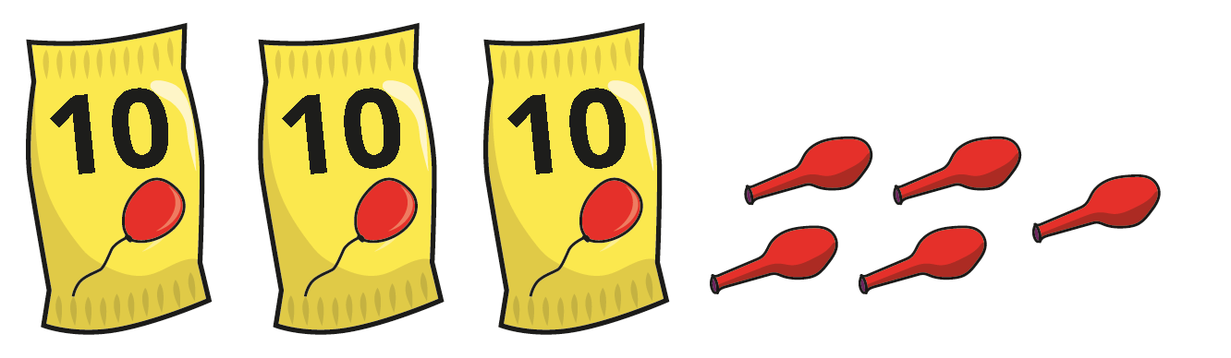
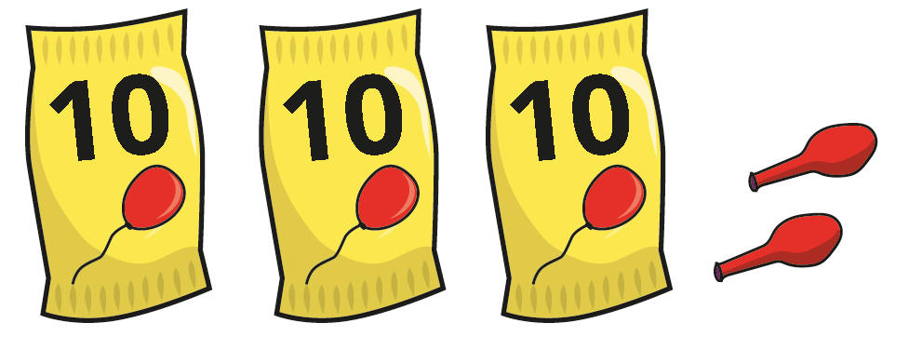
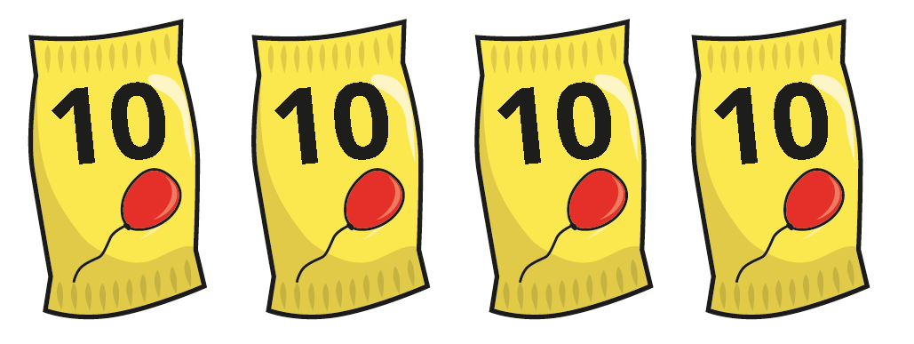
Discuss:
Dora has 35 balloons.
Who has the most balloons?
Mo has 32 balloons.
Jo
Who has the fewest balloons?
Jo has 40 balloons.
Mo
WALT: order and compare numbers

Slide 9
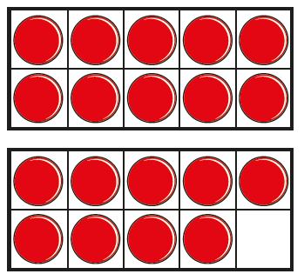
Teach it:
What numbers are shown?
54
19
56
Which is the greatest number?
56
Which is the smallest number?
19
Is there more than one answer?
56
___ $>$ ___
19
___ $<$ ___
54
56
WALT: order and compare numbers

Slide 10
Teach it:
Here is a number line.
57
58
59
60
61
62
63
64
65
66
67
68
69
70
Circle 64, 58 and 68 on the number line.
Put the numbers in order.
Start with the smallest.
64
58
68
What do you notice?
WALT: order and compare numbers

Slide 11
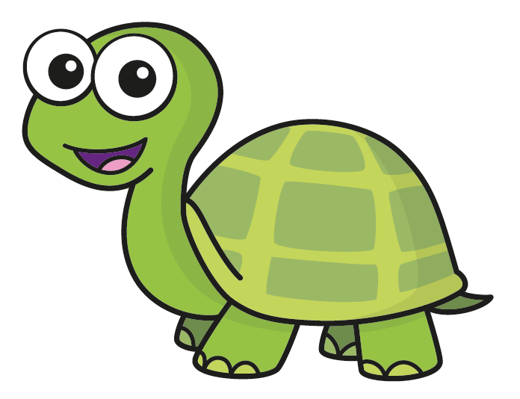

Teach it:
Here are 3 numbers.
87
78
83
Put the numbers in order.
Start with the smallest.
I could make the numbers if I am not sure.
Tiny completes this statement.
78 $<$ 83 $<$ 87
What do you notice?
WALT: order and compare numbers

Slide 12


Guided Practise:
Put the numbers in order, starting with the greatest.
45
49
47
Complete the statements.
___ $>$ ___ $>$ ___
49
47
45
45
47
49
___ $<$ ___ $<$ ___
Why is 47 in the middle for both statements?
WALT: order and compare numbers

Slide 13
Guided Practise:
Put the numbers in order, starting with the smallest.
forty-eight
fourteen
eighty-four
I think I could write the numbers in numerals to help me.
48
14
84
WALT: order and compare numbers

Slide 14

Guided Practise:
Put these numbers in order.
Start with the smallest.
56
12
49
65
59
There are a lot of numbers. What could I do to help?
Sam
12
49
56
59
65
WALT: order and compare numbers

Slide 15
Plenary –Discuss
I have learnt how to order numbers!
21
31
43
40
34
66
I think you still need practise Tiny!
WALT: order and compare numbers

