Slide 2
What I need to have ready…
My Fluency Book and Maths book
A sharp pencil
A long ruler
A rubber
A green pen for marking
A red, orange and green coloured pencil to self assess
A whiteboard and pen
The 5Bs: Brain, Book, Board, Buddy, Boss

Slide 3
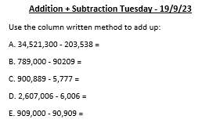
Complete the following in your small Maths Fluency Books please

Slide 4
Draw a ruler margin, then write the date and WALT and underline please
27-9-23
WALT round within 100,000

Slide 5
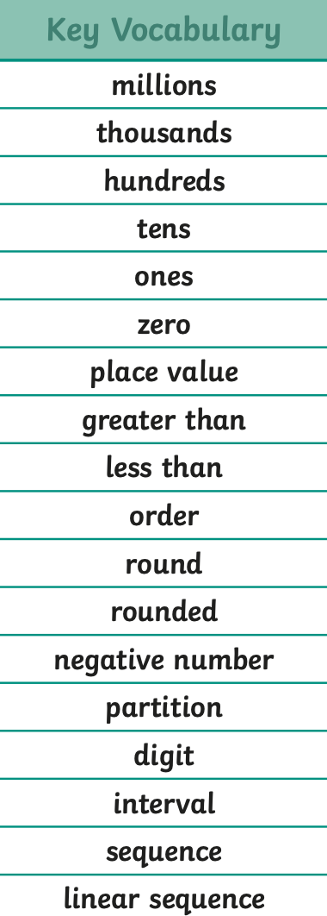
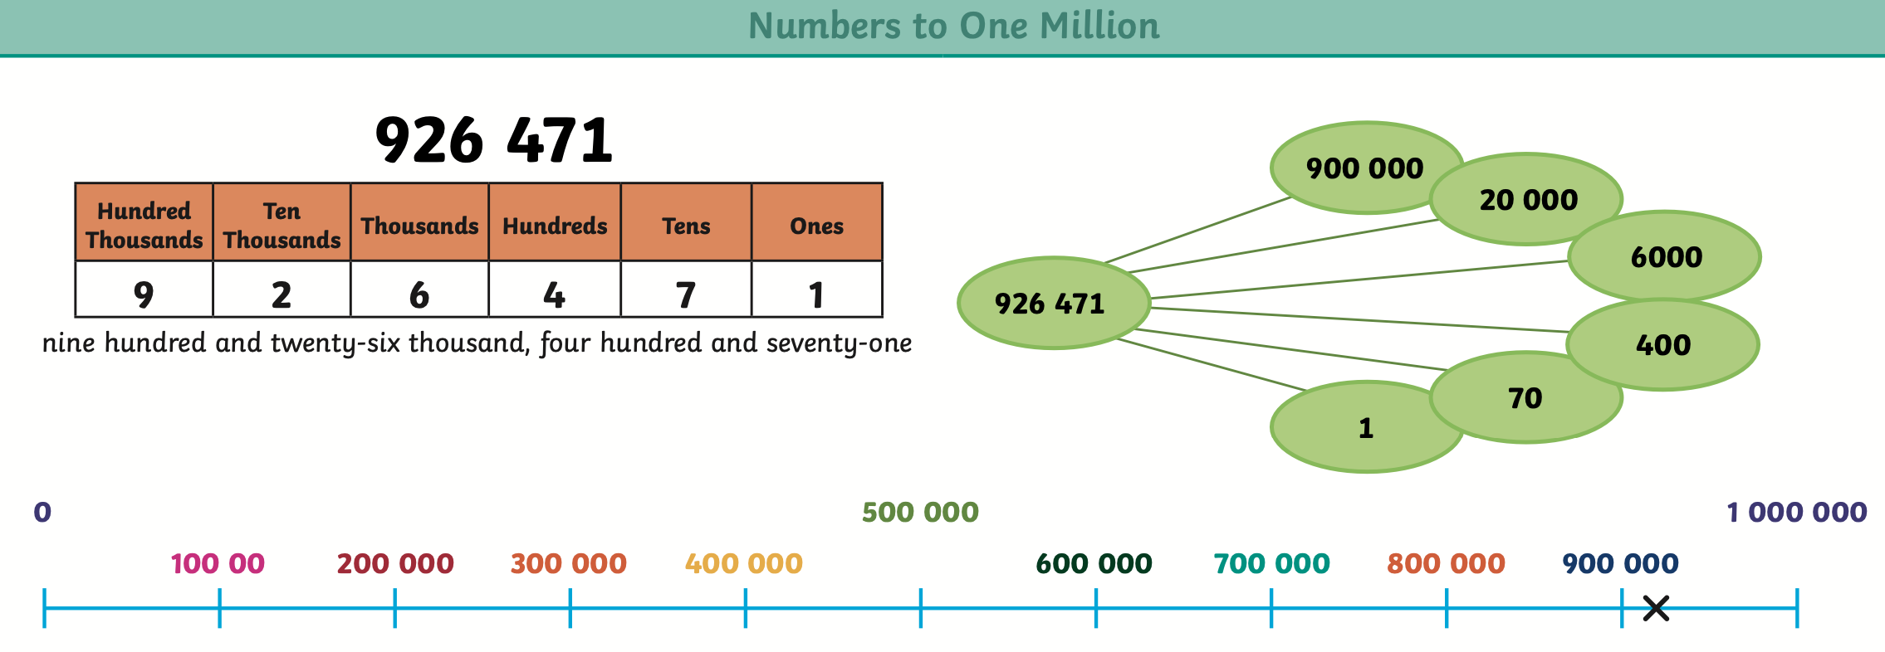
Need to Know

Slide 6
Recap
What did we learn in our last lesson?
How do you think that can help us today?
Which resources do you think will help us?

Slide 7
Fluency
1) Label the number line.
Estimate the position of 63,812 on the
number line.
3) 60,000 70,000 _____ _____
4) Round 7,443 to the nearest 1,000
60,000
70,000

Slide 8
Fluency
Round to nearest 10
Ones column
Round to nearest 100
Tens column
Round to nearest 1,000
Hundreds column
Round to nearest 10,000
Thousands
________ column
Have a think

Slide 9
Round 84,000 to the nearest 10,000
80,000
10,000
÷ 10 =
1,000
81,000
80,000
90,000
84,000
80,000
The previous multiple of 10,000 is
90,000
The next multiple of 10,000 is
84,000
80,000
90,000
is closer to than
84,000
80,000
rounded to the nearest 10,000 is

Slide 10
Round 84,000 to the nearest 10,000
80,000
Round 65,124 to the nearest 10,000
70,000

Slide 11
Round 45,000 to the nearest 10,000
50,000
Round 42,989 to the nearest 10,000
40,000
Round 3,606 to the nearest 10,000
00,000
0

Slide 12
Guided Practice
Which numbers round to 90,000 when rounded to the nearest 10,000?
99,999
79,985
100,000
80,000
85,000
90,000
8,733
94,935
10,000
90,000

Slide 13
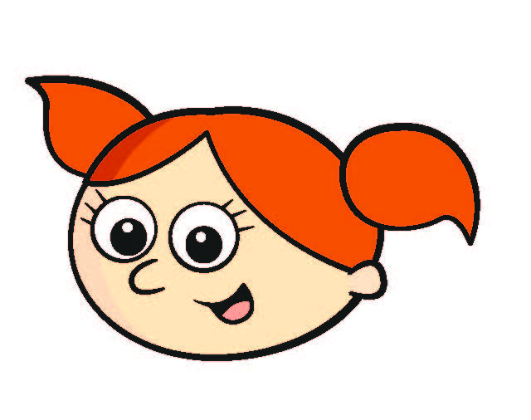
My number is 20,000 when I round it to the nearest 10,000
What is the greatest number Alex could be thinking of?
24,999
25,000
Have a think
15,000
17,000
19,000
21,000
23,000
25,000
16,000
18,000
20,000
22,000
24,000
24,999

Slide 14
Alex is thinking of a number.
It rounds to 70,000 to the nearest 10,000
It has an odd multiple of 3 as its ones digit
It has 4 tens
It has a tens digit double the hundreds digit
It has the same digit in the ten thousands and thousands places
65,000
67,000
69,000
71,000
73,000
75,000
66,000
68,000
70,000
72,000
74,000
6
6
2
4
3
9
,

Slide 16
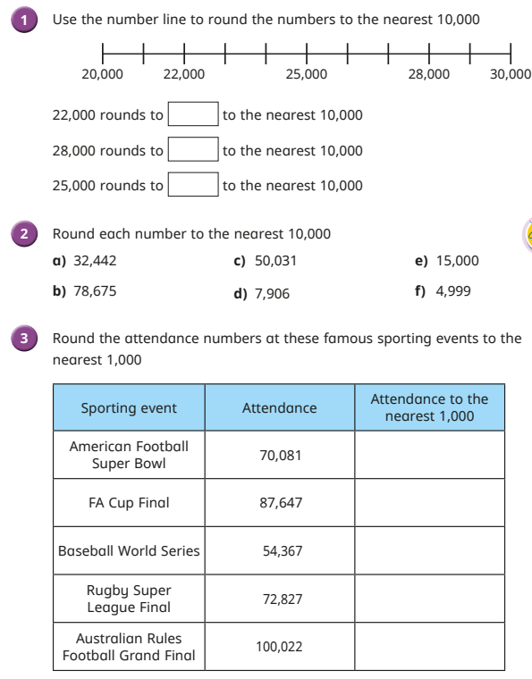
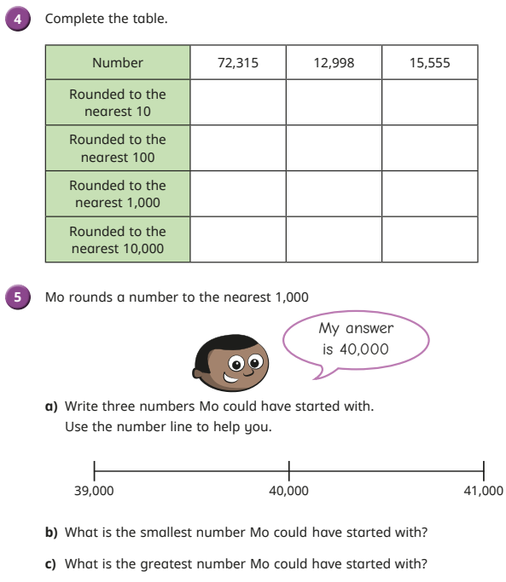
Do it
Secure it

Slide 17
Deepen it

