Slide 1
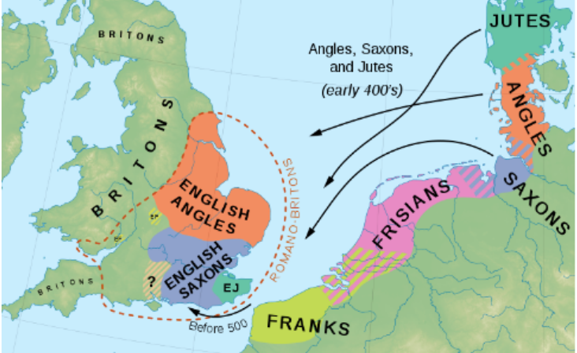
UKS2 – How did England change during the settlement of the Anglo-Saxons and Vikings?
Lesson 1 | Lesson 2 | Lesson 3 | Lesson 4 | Lesson 5 | Lesson 6 | Lesson 7 | Lesson 8
Key question What was life like at the end of the 4th Century? | Key question How did life change in England after the fall of the Roman Empire? | Key question Why did the Angles, Saxons and Jutes settle in Britain? | Key question How was Anglo Saxon Britain ruled? | Key question How did the Anglo Saxons keep control of their kingdoms? | Key question What shifts in region and power were there and how do we know this? | Key Question Who were the Vikings and why did they carry out raids? | Key Question Where did the Vikings settle and who was in charge of them?
Key vocabulary –
Aristocracy Barbarian Capital Emperor & empire Invasion Kingdom Legion Migration Monk Native Pagan Pillage & Raid Rebellion & Rebel Settlement Status Tribe
Overview of learning
Misconceptions
-We look at the Anglo-Saxons and Vikings and their achievements from 410 CE to 1066 CE.
-Firstly, we explore life in England after the fall of the Roman Empire and the reasons why the Anglo-Saxons travelled to England’s shores and decided to settle.
-Next we see how England was ruled during the settlement of the Anglo-Saxons and how they kept control of the 7 different kingdoms across the land.
-Finally, we find out who Vikings were, why they carried out raids in England and how their arrival impacted the political and social hierarchy of the time.
- Children may think that the Anglo-Saxons came from one place when they were from three different tribes.
- Children may think that the Anglo-Saxons and Vikings were separate from each other when they coexisted for a time together and they struggled for control of the land.
- Some children may think the Anglo-Saxons left and the Vikings arrived.
- Children need to understand that the Vikings are portrayed in a vicious, violent way, however that was not always the case and sources held bias.
- The change between the Romans and the Saxons happened all in 1 battle – when it actually happened over hundreds of years.
.
Disciplinary and Substantive themes explored
Disciplinary concepts – change and continuity & cause and consequence
Substantive concepts - migration, trade, monarchy, settlement, rebellion

Slide 2
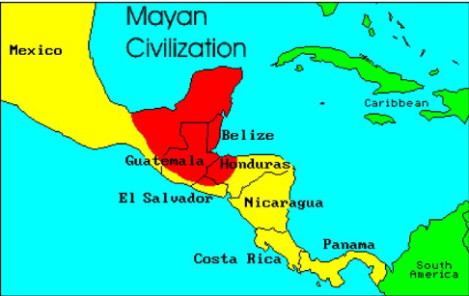
UKS2 - What similarities and differences are there between the Maya civilisation and England from the 8th to the 10th century?
Lesson 1 | Lesson 2 | Lesson 3 | Lesson 4 | Lesson 5 | Lesson 6 | Lesson 7
Key question Where and when did the Maya live and what made them a successful civilisation? | Key question How do we know about the Maya? | Key question How were the Maya ruled compared to the Anglo-Saxons? | Key question What do we know about the Maya City States and the Anglo-Saxon Kingdoms? | Key question How do the Mayan and Anglo-Saxon leaders compare? | Key question What made the Northern Mayan states thrive? | Key Question Who was involved in the struggle for power in England from the 8th to the 10th century?
Key vocabulary –
Historian archaeologist artefacts region droughts irrigate crops porous limestone jadeite settlement ravine ajaw comparing kingdom abandoned obsidian annex hostile invade trade port
Overview of learning
Misconceptions
Firstly, explore who the Maya people were, when and where in the world they lived and the reasons why they were so successful. The lessons then move on to discovering how we know about the Maya people, their beliefs and the hierarchy system that was in place in society and the important inventions that they made, especially in farming. Finally we finish with a comparison between the Ancient Maya Civilisation and Anglo-Saxon Britain, with a focus on the similarities and differences between the Maya City States and the Anglo-Saxon Kingdoms; drawing on the archaeological evidence available to us.
-Children may think that the Ancient Maya civilisation was at a much early point in history as it has the word ancient in the title.
-They may not fully grasp the idea that the Maya people and the Anglo Saxons were around at the same time- just in different parts of the world and will need to see this on a timeline.
-Maya refers to the people, culture and people without a distinction between singular and plural whereas ‘Mayan’ refers to the language(s) spoken by the Maya.
Disciplinary and Substantive themes explored
Disciplinary concepts – Similarity and difference, Evidence and interpretation
Substantive concepts – civilisation, settlement, empire, monarchy, trade

Slide 3
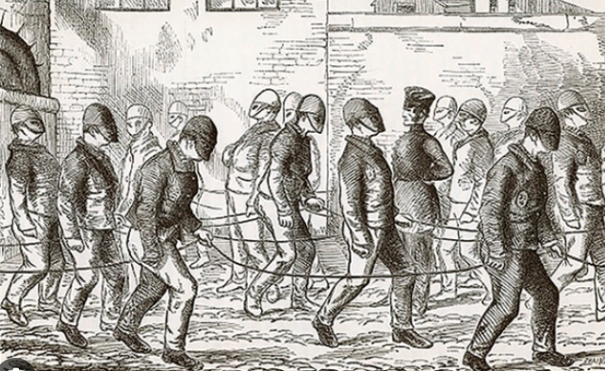
UKS2 - How has crime and punishment changed over time in Britain?
Lesson 1 | Lesson 2 | Lesson 3 | Lesson 4 | Lesson 5 | Lesson 6 | Lesson 7
Key question What is crime and punishment and what was it like in Roman Britain? | Key question What was crime and punishment like in the Anglo-Saxon period? | Key question What was crime and punishment like in the Tudor period? | Key question What was crime and punishment like in the Stuart period? | Key question What was crime and punishment like in the Victorian period? | Key question How did the police force develop through the 20th century? | Key Question What are crime and punishment like today compared with the past?
Key vocabulary –
crime period chronology deter severe court tithing wergild ordeal jury treason abolish custody incriminate pact jailer oakum industrial promotion unarmed detective prevention detection rehabilitation.
Overview of learning
Misconceptions
In this crime and punishment unit, children will build on their knowledge of periods in history that they have studied through KS2. Children will explore using different historical disciplinary concepts, how crime and punishment has changed over time in Britain. They will explore what was seen as a crime over time and the different gruesome punishments that were handed out to criminals. The children will find out about the development of the police force from the Victorian period right through to the new millennium. They should note connections, contrasts and trends over time and develop the appropriate use of historical terms. They should regularly address and sometimes devise historically valid questions about change, cause, similarity and difference, and significance.
-The children may think that the same crime that happens today, happened hundreds of years ago – when many crimes are new and laws have changed.
-Children may think that there has always been a police force.
-Children may think prisons are dungeons and that prisons have always been used as punishment, when they were originally used as holding cells before the punishment.
-Children may think the same punishments that happen today have always happened for the same crimes.
-Children may think that laws have always been the same.
Disciplinary and Substantive themes explored
Disciplinary concepts – Similarity and difference, Historical significance, Change and continuity
Substantive concepts – civilisation, empire, monarchy, rebellion

Slide 4
UKS2 - Was the Battle of Britain a significant turning point for the United Kingdom in World War Two?
Lesson 1 | Lesson 2 | Lesson 3 | Lesson 4 | Lesson 5 | Lesson 6 | Lesson 7
Key question Where is Germany and what is it like today? | Key question How did Hitler become the leader of Germany? L2/3 | Key question What changes happened when Hitler tried to expand Germany? L4/5 | Key question How did WWII begin? L6 | Key question How did WWII impact Cornwall and cities of England? L7 | Key question Why was the Royal Air Force (RAF) so important to the defence of Britain? L8 | Key Question What major victories led to Britain winning the war L9
Key vocabulary –
republic citizen state overthrow anti-Semitism debt dictator fascism nationalism authoritarian annexed territory, appeasement pact invasion air raid evacuee ration air force interception radar mobilization squadron
Overview of learning
Misconceptions
This topic will explain in full how World War Two began and give the children a wider understanding of how concepts such as empire and rebellion have influenced Hitler and his plan to dominate Europe.
The children will explore the significance of the Battle of Britain and how different areas for Britain were effected – this includes a complete a local study of Cornwall. It will look at a range of sources and then compare this to the inner cities. Finally, children will explore how Britain gained victory in World War Two and the use of the Air force as a defence.
They will also develop a strong understanding of local and world history and how the two are linked.
-Children may think that World War Two was a long time ago and that there are no longer any people alive who remember it.
-The children may think that it was one big war, when in reality it was a collection of diverse geopolitical conflicts.
-Children may think that everybody joined in the war at the same time, when in fact people joined at different times over many years.
-Children may think that everyone in the World joined, when it only affected certain counties.
Disciplinary and Substantive themes explored
Disciplinary concepts – Similarity and difference, Evidence and interpretation, Change and continuity
Substantive concepts – civilisation, empire, monarchy, rebellion, conflict

Slide 6
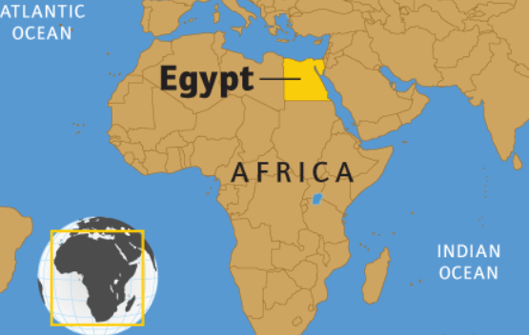
LKS2 - What were the greatest achievements of Ancient Egypt?
Lesson 1 | Lesson 2 | Lesson 3 | Lesson 4 | Lesson 5 | Lesson 6 | Lesson 7
Key question When and where was Ancient Egypt? | Key question What was life like in early Egypt and how do we know? L2/3 | Key question Did the Ancient Egyptians have religion? L4/5 | Key question How were the pyramids built? L6 | Key question What were the consequences of invasion on the Old Kingdom of Ancient Egypt? L7 | Key question What were the success of the New Kingdom and who ruled over it? L8/9 | Key Question How did the Egyptian Empire end?L10
Key vocabulary –
Era artefact chronology scribe hieroglyphs polytheistic obelisk temple preserve prepare pyramid chamber Egyptologist chariot invade bronze navy archer trade expand monarchy empire
Overview of learning
Misconceptions
To begin with, children learn about how early civilisation started within Egypt. They shall discover how the upper and lower kingdoms joined together to create the Ancient Egypt of the Old Kingdom. Next, children will compare the Egyptian time period to Neolithic in Britain, to find out what was happening at the same time and how these two civilisations compared. Finally, children will then discover all about the Egyptian gods, what Ancient Egyptians believed about the afterlife, how the pyramids were built and discuss who the greatest pharaoh was in all of Egypt’s history. They should construct informed responses that involve thoughtful selection and organisation of relevant historical information. They should understand how our knowledge of the past is constructed from a range of sources.
-The children may think that the Ancient Egyptian period happened after or before a period in British history, rather than alongside it.
-They may think that changes happened very suddenly, rather than over time.
-The children may think that slaves built the pyramids when it was actually skilled workers.
-They may think that tombs have booby traps in them when this is historically inaccurate.
Disciplinary and Substantive themes explored
Disciplinary concepts – Similarity and difference, Evidence and interpretation
Substantive concepts – civilisation, settlement, empire, monarchy, trade, rebellion

Slide 7
LKS2 - What were the greatest achievements of Ancient Greece?
Lesson 1 | Lesson 2 | Lesson 3 | Lesson 4 | Lesson 5 | Lesson 6
Key question What can excavations tell us about life in early Greece? L1/2 | Key question How did the Minoans trade in early Greece? L3 | Key question What was life like in Athens and Sparta? L4 | Key question How did the city-states overcome the Persians and what was it like afterwards? L5/6 | Key question How did King Philip ll grow the Macedon Empire? L7 | Key question Who was Alexander the Great and what made him a significant leader? L8
Key vocabulary –
civilisations ceramics excavate Crete trade complex export bronze import oligarchy city-state outnumber invasion empire retreat revolt unified militaristic policy tyrant victorious
Overview of learning
Misconceptions
This unit looks at the Ancient Greeks and their achievements from around 3000 BCE to the reign of Alexander the Great around 330 BCE. Firstly, we focus on the Minoans and how they began to trade in early Greece. The children will also think about and discuss how we know about the early Greeks, by looking at excavation evidence and what this tells them. The next few lessons in the teaching sequence are on life in Athens and Sparta, the Persian invasion and the impact this had on life in the city-states. Finally, we look at the leadership of Ancient Greece under the rule of King Philip ll and then Alexander the Great. Children will conclude their learning with a final response to the main historical enquiry,
-Children will need a sound understanding of the dating system BCE (Before Common Era) before they begin this unit. It will need to be taught explicitly. As this may confuse the children when faced with dates such as 352 BCE and 323 BCE. Children may think 352 BCE is later in time. They will need to be corrected and frequent looks at a historical timelines will help this.
-The children may believe that ancient Greece were before/after to other civilisations, so will need to understand what else was happening in the world.
Disciplinary and Substantive themes explored
Disciplinary concepts – Evidence and interpretation, Chronology, Historical significance
Substantive concepts – civilisation, settlement, empire, monarchy, trade

Slide 8
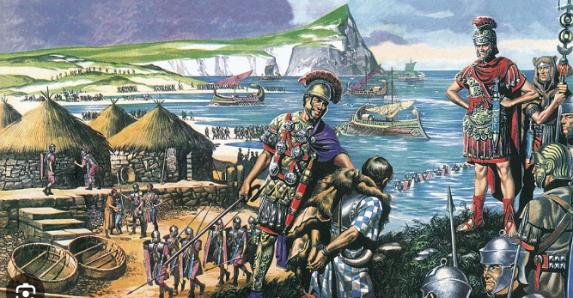
LKS2 - What were the greatest achievements of Ancient Rome?
Lesson 1 | Lesson 2 | Lesson 3 | Lesson 4 | Lesson 5 | Lesson 6 | Lesson 7
Key question What do we know about early Rome & how do we know this? L1 | Key question Who was in charge of the Roman Empire and did they have a powerful army? L2/3 | Key question What events led up to Emperor Claudius invading Britain? L4 | Key question How did the Roman settlements compare to the Celtic villages? L5 | Key question Who was Boudicca and why did she take revenge on the Romans? L6 | Key question How did the Romans protect their land and do we know this? L7 | Key question What happened in the final years of the Roman Empire? L8
Key vocabulary –
archer infantry fleet annex military alliance legion emperor empire peninsula tactic settlement kingdom revolt occupation outnumber governor conquer defenses civil war pillage.
Overview of learning
Misconceptions
This unit looks at the Romans and their achievements from 43 CE to 410 CE. The first lessons explore what life was like in early Rome, who was in charge and held the power across the Empire and how the emperors trained up their powerful armies.
This then moves onto the Roman invasion of Britain; a comparison between the existing Celtic villages and the new Roman settlements, alongside finding out how the Romans protected their new lands and an introduction to significant historical figures of the time such as Boudicca.
Finally, we finish with a study of the final years of the Roman Empire and the events led to its downfall.
-Children may believe that Julius Caesar was the first emperor of Rome because he made attempts to invade Britain earlier, however Augustus was the first Roman emperor.
-Children may think that the Roman Empire was just modern day Italy and then it expanded to include Britain.
-Children may think that the Romans got rid of the celts, when in actual fact there was a blending of cultures and a distinct Romano-Celtic culture was created.
-Children may think that the Romans made Britain worse, when they actually bought new ideas
Disciplinary and Substantive themes explored
Disciplinary concepts – Similarity and difference, Chronology, Historical significance
Substantive concepts – civilisation, settlement, empire, monarchy, trade, rebellion

Slide 9
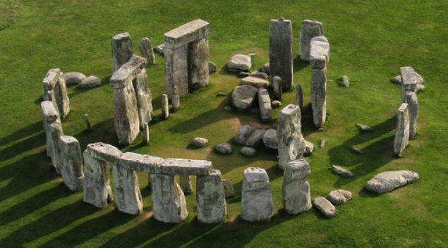
LKS2 – How did life change in Britain from the Stone to the Iron Age?
Lesson 1 | Lesson 2 | Lesson 3 | Lesson 4 | Lesson 5 | Lesson 6 | Lesson 7
Key question What was life like in the Paleolithic and Mesolithic and how did it change? L1/2 | Key question What did people eat in the Paleolithic and Mesolithic? L3 | Key question How did the search for food change in the Neolithic? L4 | Key question What tools were used in the Neolithic – and who were the beaker people? L5/6 | Key question How did tools change after the Neolithic? L7 | Key question How did the Bronze age move into the Iron Age? L8 | Key question What were hillforts and roundhouses? L9/10
Key vocabulary –
artefacts excavation archeologist continuity remains migrate preserve agriculture domestication significant, mine ore alloy beaker burial construct settlement palisade granary ditch
Overview of learning
Misconceptions
In this unit, children learn about prehistory in Britain, and how we find out about prehistory. They discover what life was like through each of the main time periods of the Stone Age, right through to the Iron Age. Children find out about civilisation started, how agriculture became a huge driving force for things like stone circles to be built and how different metals such as bronze and iron changed the way we interacted with each other and created huge defensive earthworks that we can even see and walk today.
-Children may think that the Stone Age is one whole age and may not fully grasp the idea of how long the Paleolithic was.
-Children may think that changes happened suddenly rather than over time.
-Children may think that iron was used because it was a stronger metal rather than it being a more commonly available metal.
Disciplinary and Substantive themes explored
Disciplinary concepts – Society and Community
Substantive concepts – migration, settlement, trade, civilisation, industry

Slide 11
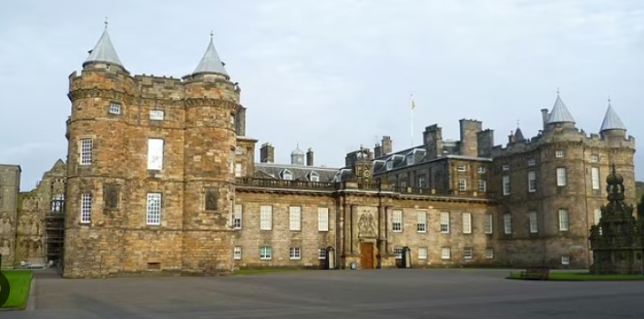
KS1 – How have children’s toys changed since our older relatives were little?
Lesson 1 | Lesson 2 | Lesson 3 | Lesson 4 | Lesson 5 | Lesson 6
Key question How can we find out about the past? | Key question What are our toys like now? | Key question What was my favourite toy when I was a baby? | Key question What were our caregivers’ toys like and how do we know? | Key question What were our older relatives’ toys like and how do we know? | Key question How have children’s toys changed since our older relatives were little?
Key vocabulary –
Before after past present old new then now today modern timeline different same favourite
Overview of learning
Misconceptions
We will look at the changes in toys over the past 60 years. The children will begin by looking at modern day toys and they will discuss and make comparisons between the toys they play with in the modern day. Each lesson then looks back a little further in time, with the children looking at the toys they played with when they were babies, the toys their parents had when they were a similar age to them, and concludes with them looking at the toys that their grandparents had when they were younger. The chronology of these events is clearly marked on a timeline to help their understanding of the past. Throughout all of these lessons, children will discuss what things we do to help us find out about the past. The children will learn about being a history detective and will be encouraged to ask questions, make comparisons and use evidence to help them come to conclusions.
-Children may think that their parents and grandparents played with completely different toys to them; however, there are many similarities between the toys of now and 60 years ago.
The differences are mainly with what the toys were made out of and what the toys can do now that they couldn’t back then.
Disciplinary and Substantive themes explored
Disciplinary concepts – Society and Community
Substantive concepts – trade, civilization, industry

Slide 12
KS1 - Where did kings and queens live through time?
Lesson 1 | Lesson 2 | Lesson 3 | Lesson 4 | Lesson 5 | Lesson 6 | Lesson 7
Key question How can we find out about the past? | Key question Why did monarchs build castles? | Key question Who were the kings and queens of the past? | Key question Who was Queen Victoria, and where did she live? | Key question Who was the first Queen Elizabeth? | Key question Why do we remember King William I? | Enquiry Research about a King or Queen of the past and where they lived
Key vocabulary –
King/Queen reign monarch coronation past present moat drawbridge battlements attack defend protect Buckingham Palace Windsor Castle Balmoral Castle monument scepter similar regal significant change continuity
Overview of learning
Misconceptions
Children will learn about famous and significant kings and queens of England, from King William I in 1066 to King Charles III in the present day. Children will start to consider how we learn about the past and how it is similar to a detective. They will then think about castles and why they were built. Children will identify some of the features of a castle and what they are used for. The lessons then continue to look at each significant king or queen in turn, going back in time chronologically. Children will learn a little about their lives and which palaces and castles were significant to them. The children will compare monarchs of different times that lived in the same castle and have the opportunity to point out differences between the monarchs of the past. Finally children will be given the chance to put their historical skills to the test and research about a king or queen of their choosing.
-Lessons start in the present day with King Charles III and go back chronologically in time to look at and discuss Queen Elizabeth II, Queen Victoria, Queen Elizabeth I and King William I (William the Conqueror).
-Children need to be taught that these Kings and Queens weren’t the only monarchs in our history-there were others in between. E.g. Queen Victoria and Queen Elizabeth II's reigns weren't next to each other-there were monarchs between them.
-Lessons have picked out some monarchs of the past, but not all. This needs to be explicitly taught and emphasised in the lessons.
Disciplinary and Substantive themes explored
Disciplinary concepts – Historical significance, chronology, change and continuity
Substantive concepts – empire, monarchy, reign

Slide 13
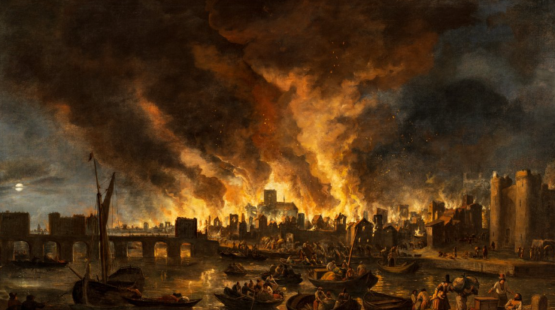
KS1 - What happened to London during the fire of 1666?
Lesson 1 | Lesson 2 | Lesson 3 | Lesson 4 | Lesson 5 | Lesson 6
Key question What was London like in 1666? | Key question What happened on 2nd September 1666? | Key question How did the fire spread, and how do we know? | Key question What was left of London? | Key question How was London rebuilt? | Key question How did the fire impact the future?
Key vocabulary –
evidence present past now then Lord Mayor fire hook diary Samuel Pepys significant archaeologist modern-day Christopher Wren St Paul’s Cathedral chronological order timeline
Overview of learning
Misconceptions
Misconceptions
To begin with, children will discover what London was like in 1666 and they will make simple comparisons between then and the present day. Next, the lessons will move on to discover what happened on the night of 2nd September 1666 when the Great Fire of London started. Children will discuss why the fire spread quickly and how it was tackled. The children will be introduced to key historical individuals, such as Thomas Farriner, Samuel Pepys, King Charles II and Christopher Wren. The children will consider how we find out about the past. They will have the opportunity to study evidence, such as Samuel Pepys’ diary and objects left behind after the fire, to help them form opinions about what happened over 350 years ago.
A major part of this unit will be the children understanding the cause and consequences and knowing that some positives came from this event.
-Children may believe that all houses and buildings were made of wood until after the Great Fire of London when they were ordered to be rebuilt. However, some buildings made of stone and brick did exist before the fire. The wooden houses just contributed to the spread of the fire.
-The whole of London burnt down, this was not the case and need to understand only part of it burnt but that was enough to cause huge changes.
-There were lots of positive impacts that came from this, it wasn’t all bad.
Disciplinary and Substantive themes explored
Disciplinary concepts – Historical significance, cause and consequence, similarity and difference
Substantive concepts – monarchy, civilisation

Slide 14
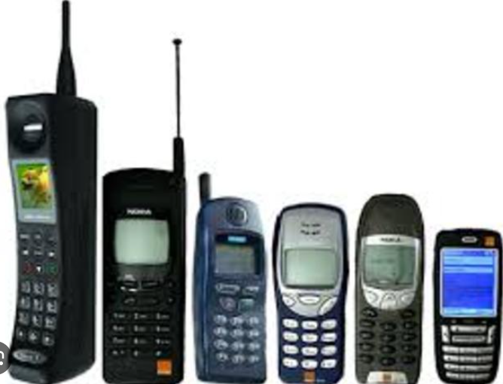
KS1 – How has technology changed in the last 60 years?
Lesson 1 | Lesson 2 | Lesson 3 | Lesson 4 | Lesson 5 | Lesson 6
Key question How can we find out about the past? | Key question How has technology changed how we write? | Key question How has technology changed how we communicate? | Key question How has technology changed the way we are entertained? | Key question Who are the important inventors in the history of technology? | Key question Research a piece of technology they are interested in.
Key vocabulary –
Before after past present then now today modern timeline different same technology evidence
Overview of learning
Misconceptions
Misconceptions
This unit looks at the changes in technology over the past 60 years. The children will begin by thinking about the term ‘technology’ and what that means. They will then consider the technology that they use in their everyday lives. The lessons then look back at technology of the past, spanning 60 years.
Next we focus on a specific kind of technology e.g technology to help us write, talk and be entertained. Children will make comparisons between technology of the past and the modern day, thinking about how our lives have changed with the advances in technology. Next we think about historical figures in the history of technology, e.g. Tim Berners-Lee and the impact his inventions have had. Children will discuss what things we do to help us find out about the past. The children will learn about being a history detective and will be encouraged to ask questions, make comparisons and use evidence to help them come to conclusions.
-In these lessons children focus on technology that was used 60 years ago.
-They must not assume that the technology that was used 60 years ago was invented 60 years ago. e.g the typewriter was commonly used 60 years ago, but was actually invented 100 years prior.
-Children may think that new technology is all made brand new when actually it could be adaptions from past technologies.
Disciplinary and Substantive themes explored
Disciplinary concepts – Similarity and difference, Change and continuity, Chronology
Substantive concepts – trade, industry

Slide 15
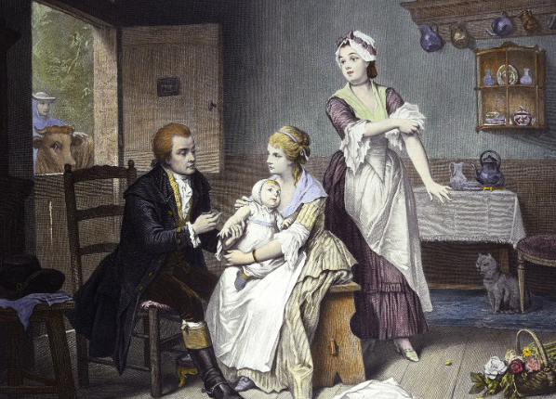
KS1 – How did Florence Nightingale and Edith Cavell help to improve hospitals?
Lesson 1 | Lesson 2 | Lesson 3 | Lesson 4 | Lesson 5 | Lesson 6
Key question How can we find out about the past? | Key question Who was Florence Nightingale, and why was she important? | Key question Who was Edith Cavell Nightingale, and why was she important? | Key question When did Florence and Edith become significant? | Key question Why did Florence and Edith act the way they did? | Key question How has the past been represented?
Key vocabulary –
Before after, past, present, old, new, then, now, today, modern, timeline, different, same, similar,
compare, decade, century, pioneer, discrimination
Overview of learning
Misconceptions
Misconceptions
This unit looks at the changes in hospitals and healthcare over the years and the significant people involved. Our lessons focus on Florence Nightingale and Edith Cavell. Children will begin by finding out about the past through pictures of old and new hospitals and healthcare workers. The lessons explore who Florence Nightingale and Edith Cavell were and why they were significant. The children will build on their chronological understanding of the past by using timelines and constructing one themselves. They will have the opportunity to consider which of the British Values were displayed by Edith. The lessons then move on to looking at how the past has been represented. The children will compare the past and present and spot the difference between hospitals and healthcare over the years.
-Florence Nightingale and Edith Cavell weren't the first nurses. They were significant because of how they acted and their changes.
-Children may think that he NHS has always been here.
-Children may not realise that not everyone could afford healthcare in the past.
Disciplinary and Substantive themes explored
Disciplinary concepts – Similarity and difference, Change and continuity, Chronology
Substantive concepts – empire, industry

Slide 16
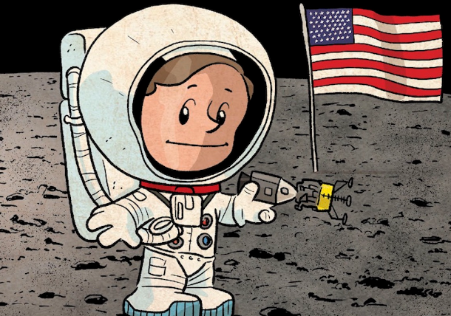
KS1 – Where have humans explored?
Lesson 1 | Lesson 2 | Lesson 3 | Lesson 4 | Lesson 5 | Lesson 6
Key question How can we find out about the past? | Key question Why do people explore? | Key question Who are the important explorers from the past? | Key question What are the famous explorations of the past? | Key question Can we compare different explorations? | Key question How have explorations changed over time?
Key vocabulary –
explore explorer exploration significant astronaut oceanographer mountaineer before after past present monument same different change continuity then now
Overview of learning
Misconceptions
Misconceptions
To begin with, children will be exposed to images of different explorers: explorers that explore different parts of the world. The children will discuss where in the world these explorers may have been and the special equipment that they need to survive. Over the next few lessons, children will be introduced to some famous explorers from the past. They will find out more about their lives and the reasons why they became explorers. During this unit, they will ‘meet’ Charles Darwin, Neil Armstrong, Ibn Battuta, Roald Amundsen, Sylvia Earle and Edmund Hillary. They will have the opportunity to ask and answer questions about them and make simple comparisons between their explorations. At the end of the unit, children will consider modern day explorations and whether or not humans will still explore the Earth and beyond in the future.
-Neil Armstrong - First man on the Moon, but not the only human to have been to the Moon. There have been Moon landings since 1969 (12 people have landed there in total). -Roald Amundsen - First man at the South Pole, he was also the first to fly over the North Pole, but many other people have been since then. He isn’t the only explorer to have made it.
-The explorations we study from the past, are not the only ones but we can’t look at all of them as there are thousands.
Disciplinary and Substantive themes explored
Disciplinary concepts – Change and continuity, Exploration and Invasion
Substantive concepts – exploration, trade

